Slide 1
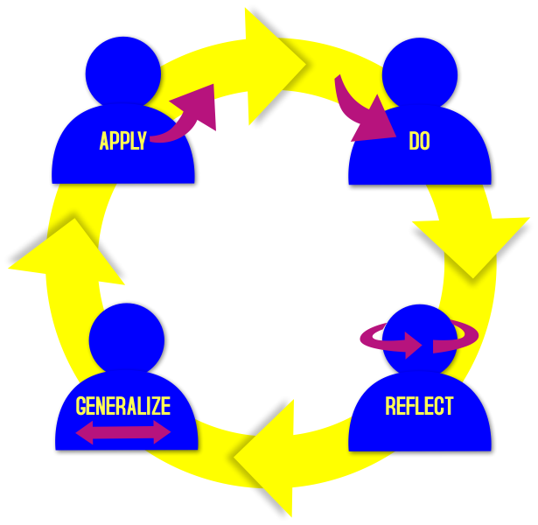
Tsugi Tools
Charles Severance
University of
Michigan
https://github.com/csev/talks
https://www.tsugi.org/awesome

Slide 2
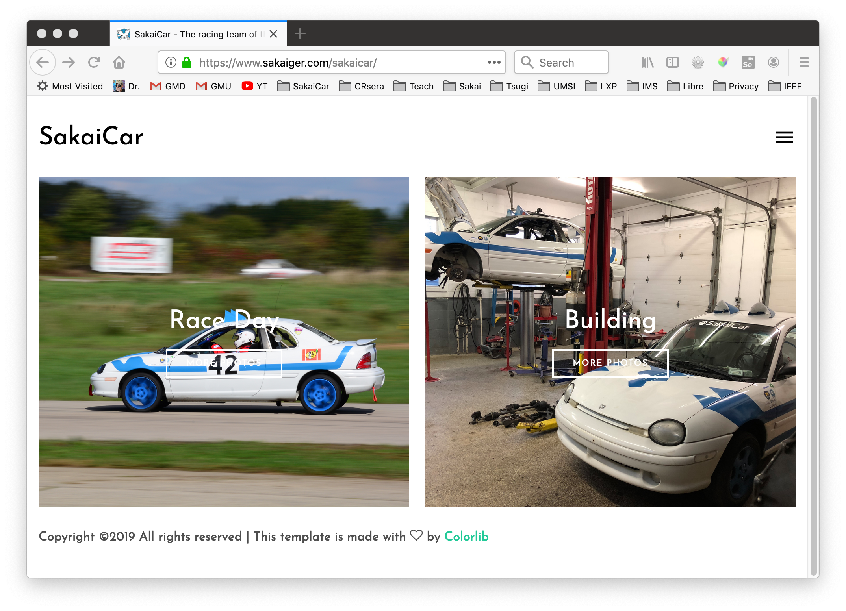

Slide 3



Overall
Building LMS integration standards and solutions is my research
www.tsugi.org is a 100% open source project with an Apache license
Free to use
Free to host
Free to charge for
Free to modify and keep your modification
Everything works with Sakai

Slide 4




What is www.tsusgi.org (TL;DR)
IMS LTI Advantage® IMS Deep Linking® IMS Common Cartridge®
The LMS
BUS uses ☺
次Tsugi
Tools
The LMS
CS Uses ☺

Slide 5
What's in www.tsugi.org for me?
Teachers find and use tools in stores like www.tsugicloud.org
Instructional Designers build custom tools, assessment and content for your faculty
IT / Support can quickly build learning tools for the LMS without reading specifications
Content Authors can build supporting materials and tools to use and share like www.py4e.com
https://www.tsugi.org/awesome

Slide 6


Choose Your Own Adventure
Active Learner: https://www.tsugi.org/awesome
Passive Learner: Sit back and relax
https://www.tsugi.org/awesome

Slide 7
Adventure Outline
Instructions - https://www.tsugi.org/django_sakai.txt
Make an account on www.pythonanywhere.com
Set up virtual environment
Pull down https://github.com/tsugiproject/djtest
Get it running in PythonAnywhere
Link it into dev1.tsugicloud.org
Optional
Install it into your LMS as an LTI tool
Launch as student – send a grade from Django to your LMS
https://www.tsugi.org/awesome

Slide 8
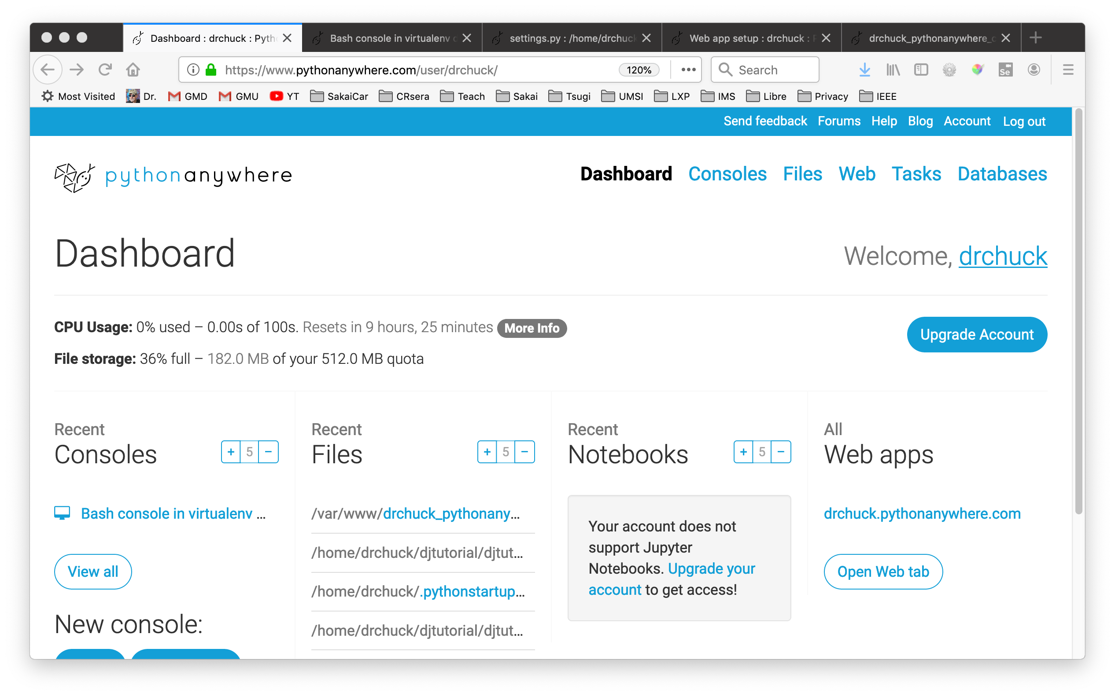
https://www.tsugi.org/awesome

Slide 9
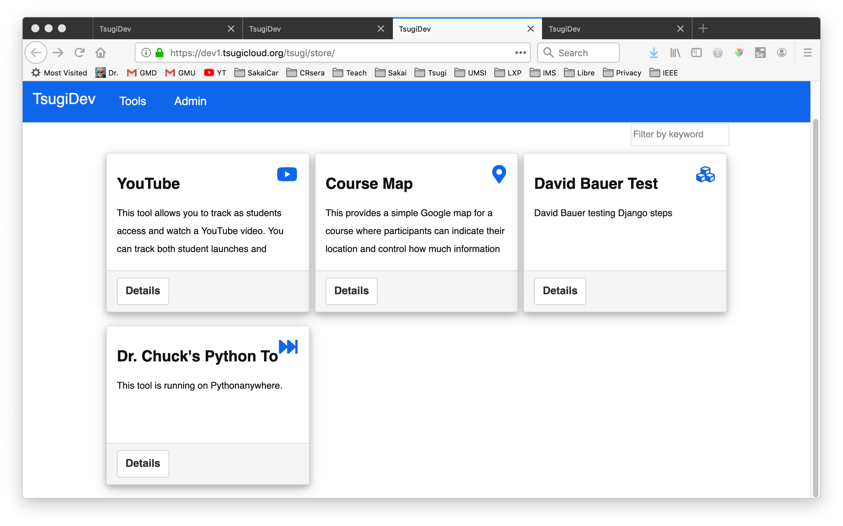
https://www.tsugi.org/awesome

Slide 10
Learning App Stores

Slide 11
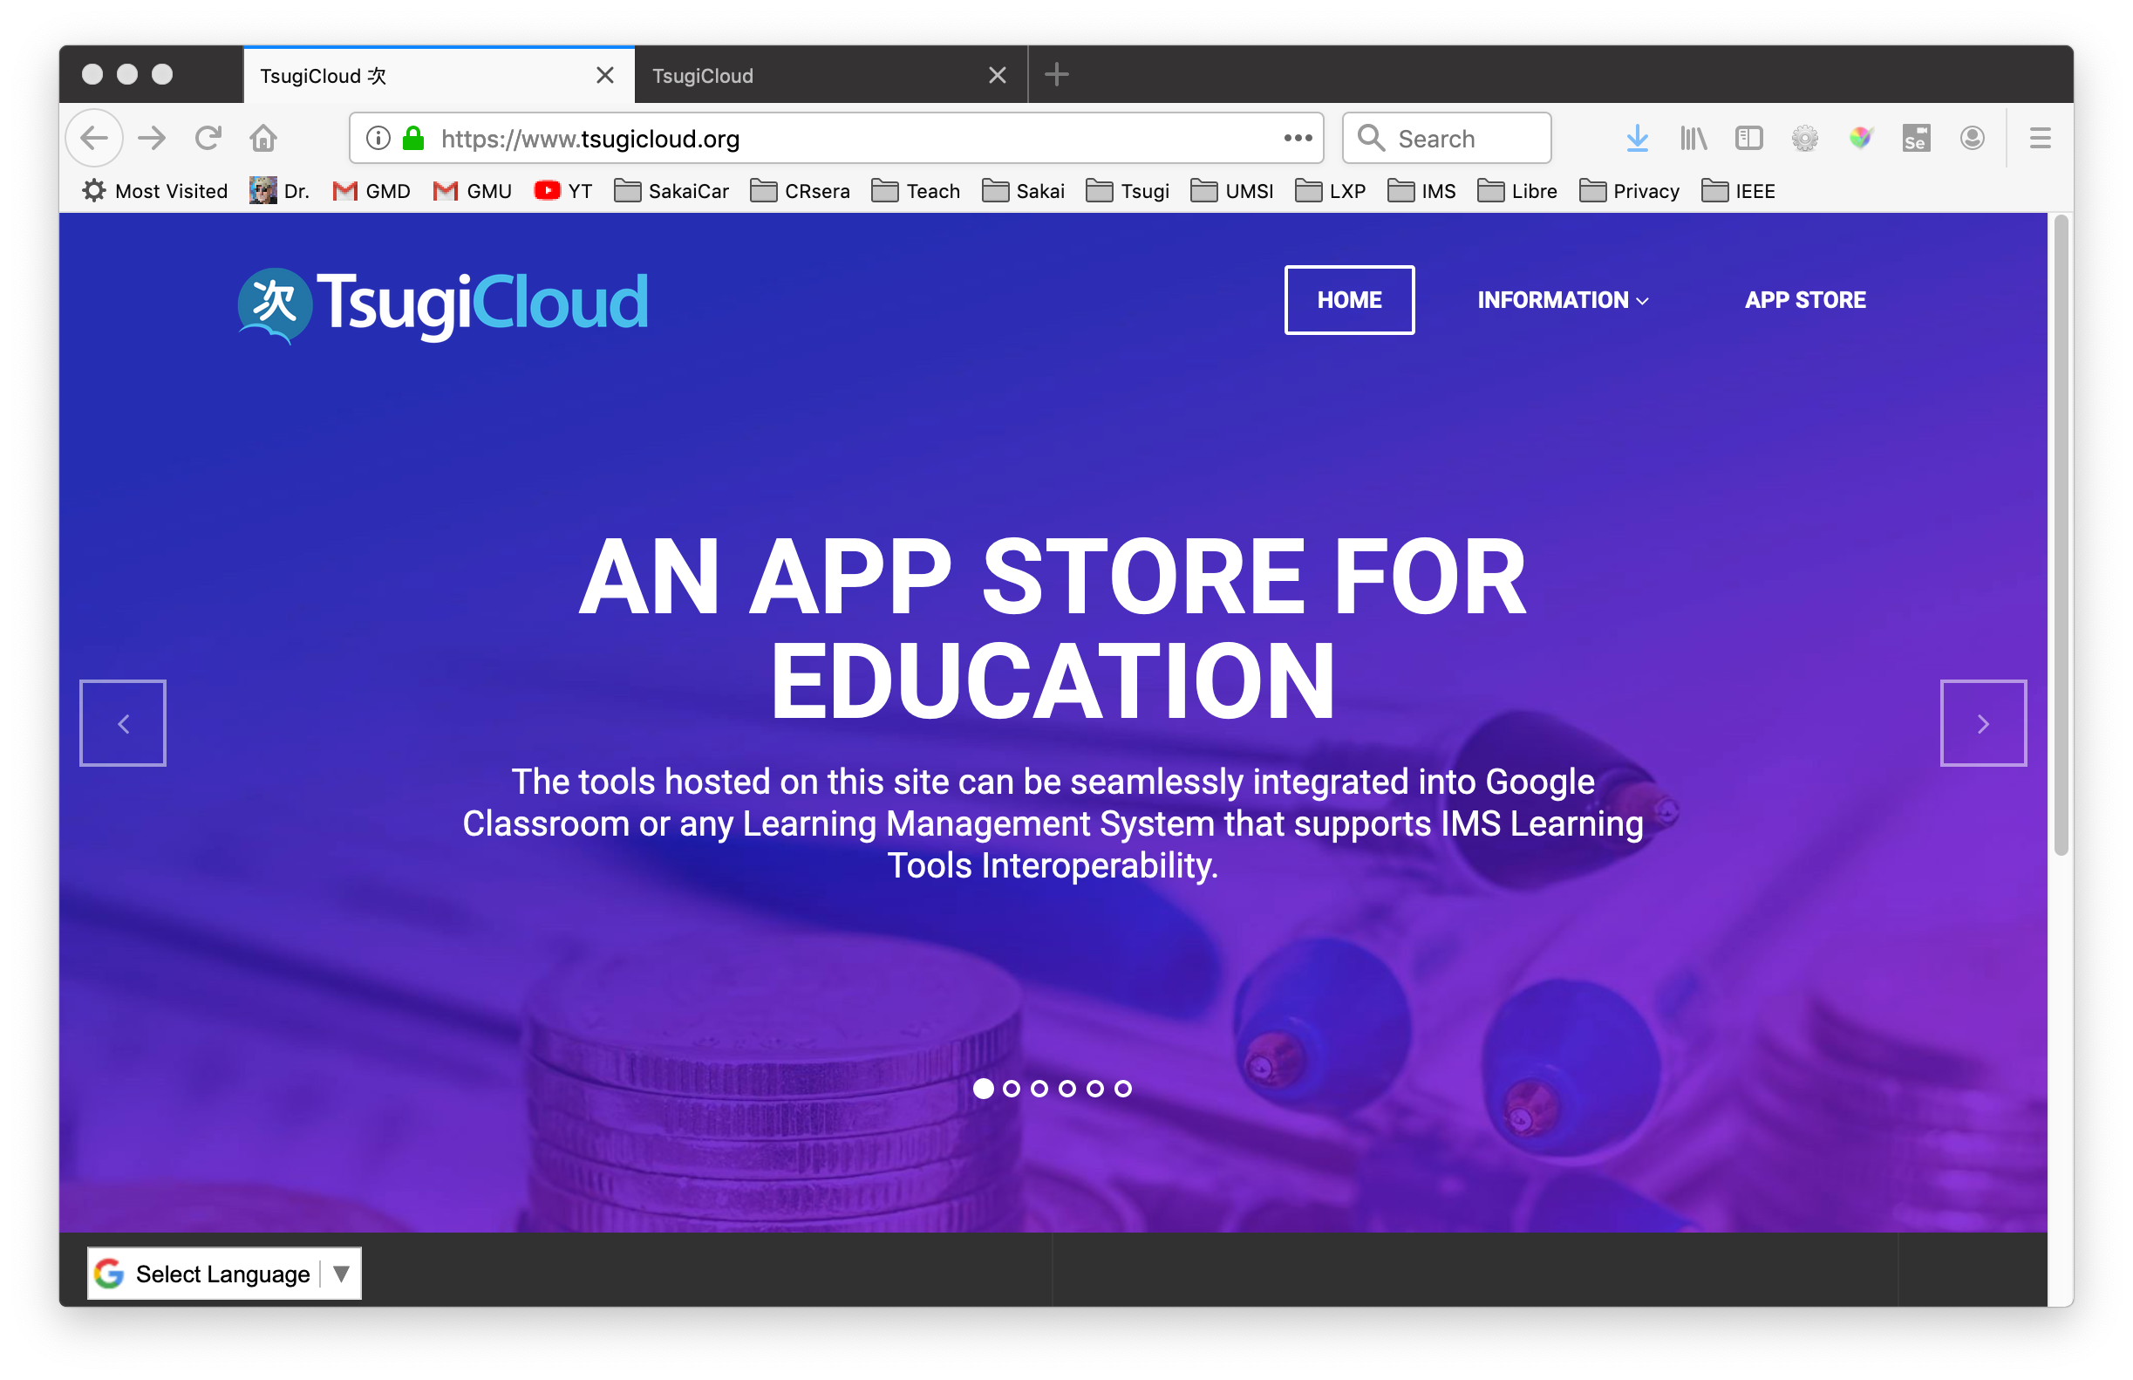

Free Hosted Learning Apps
https://www.tsugicloud.org

Slide 12
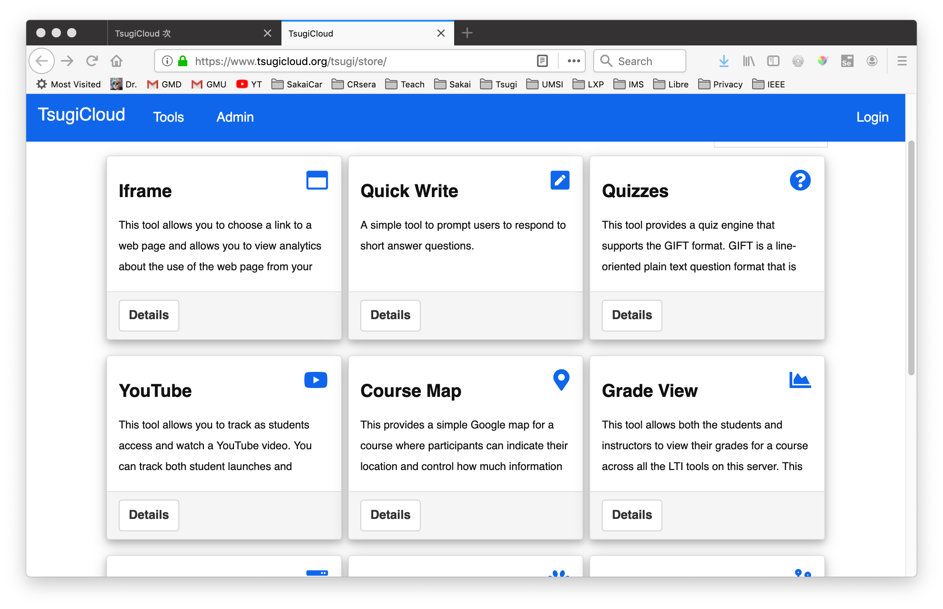
Free Hosted Learning Apps
https://www.tsugicloud.org

Slide 13
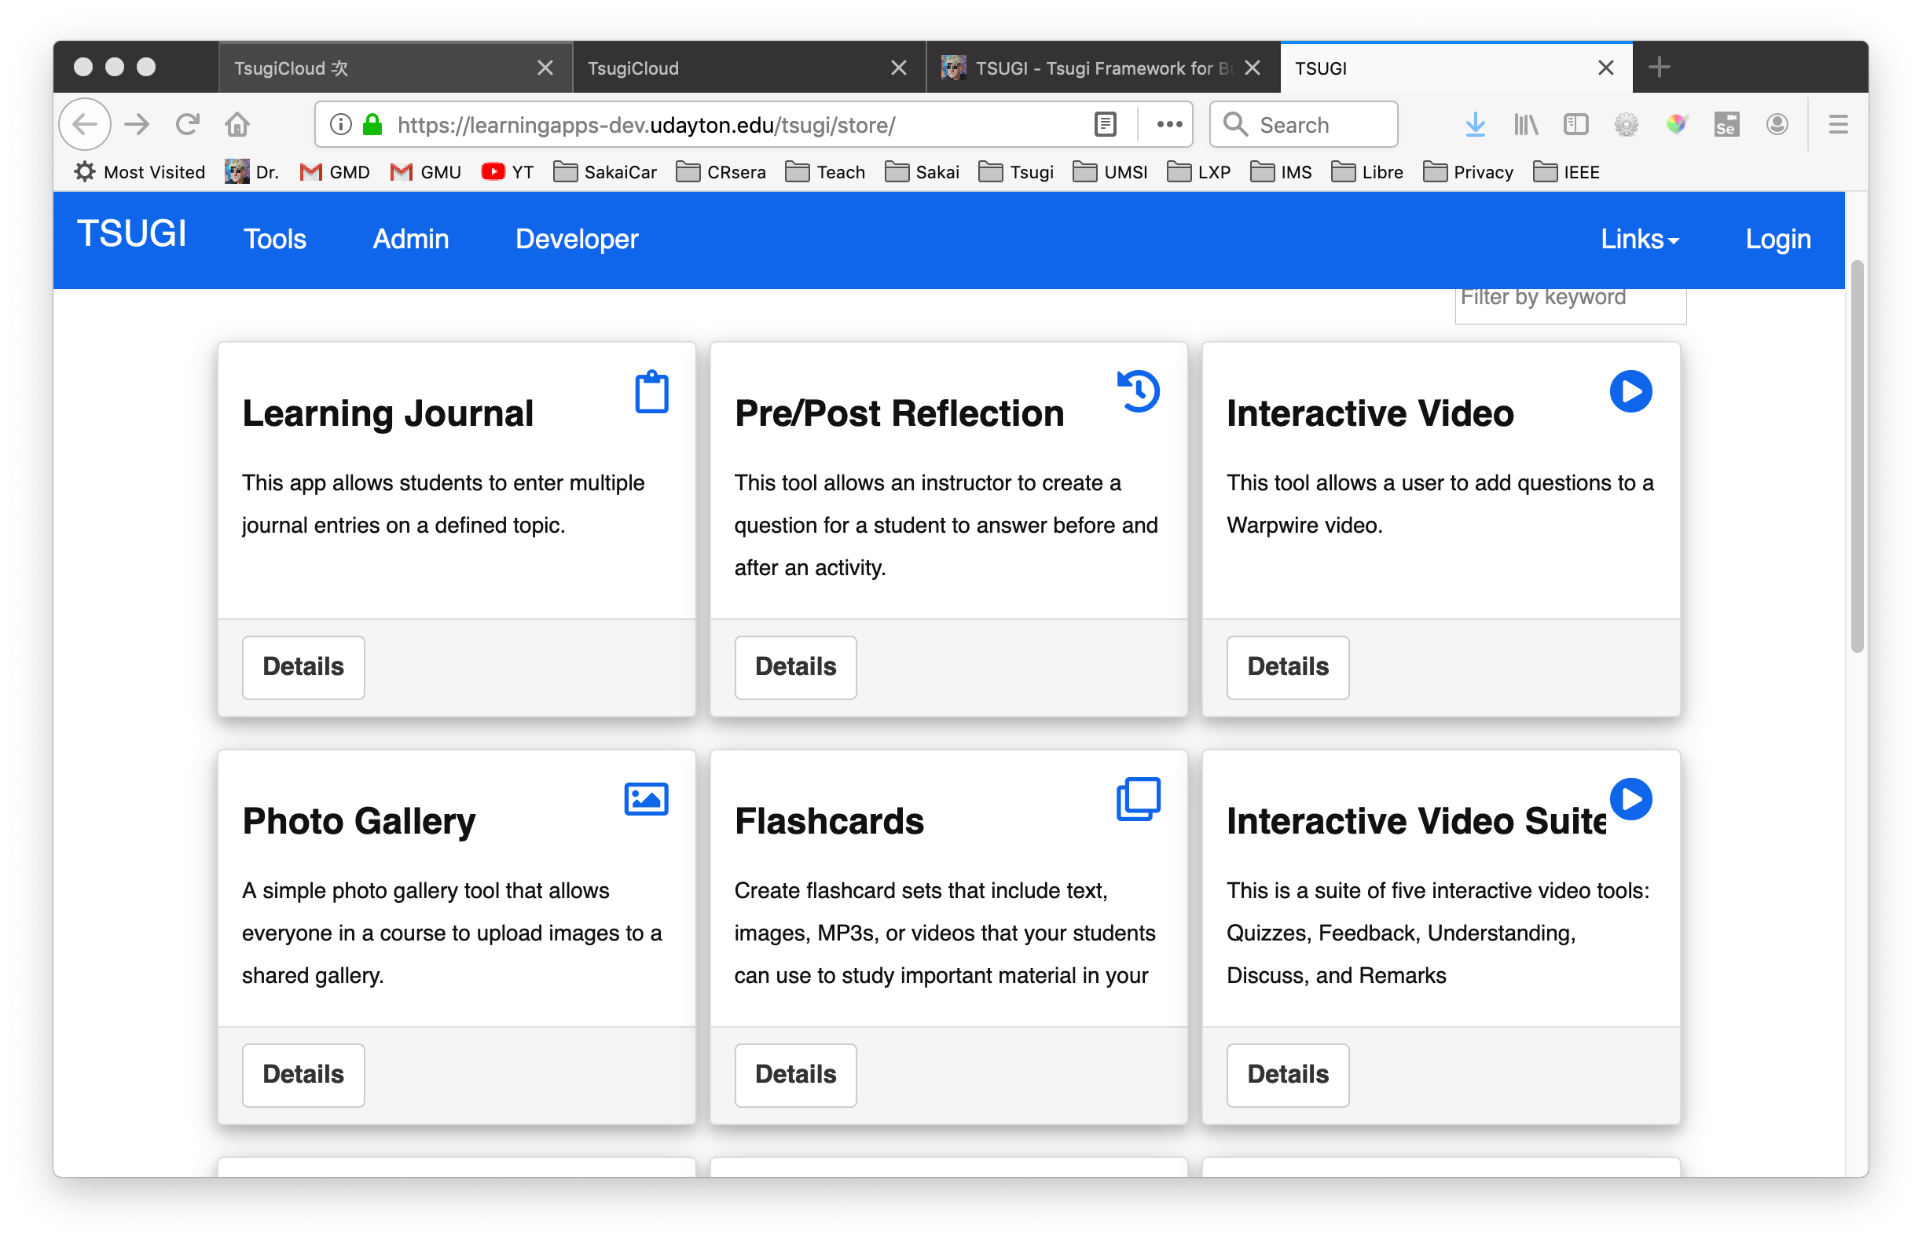

https://learningapps-dev.udayton.edu/tsugi/store/

Slide 14
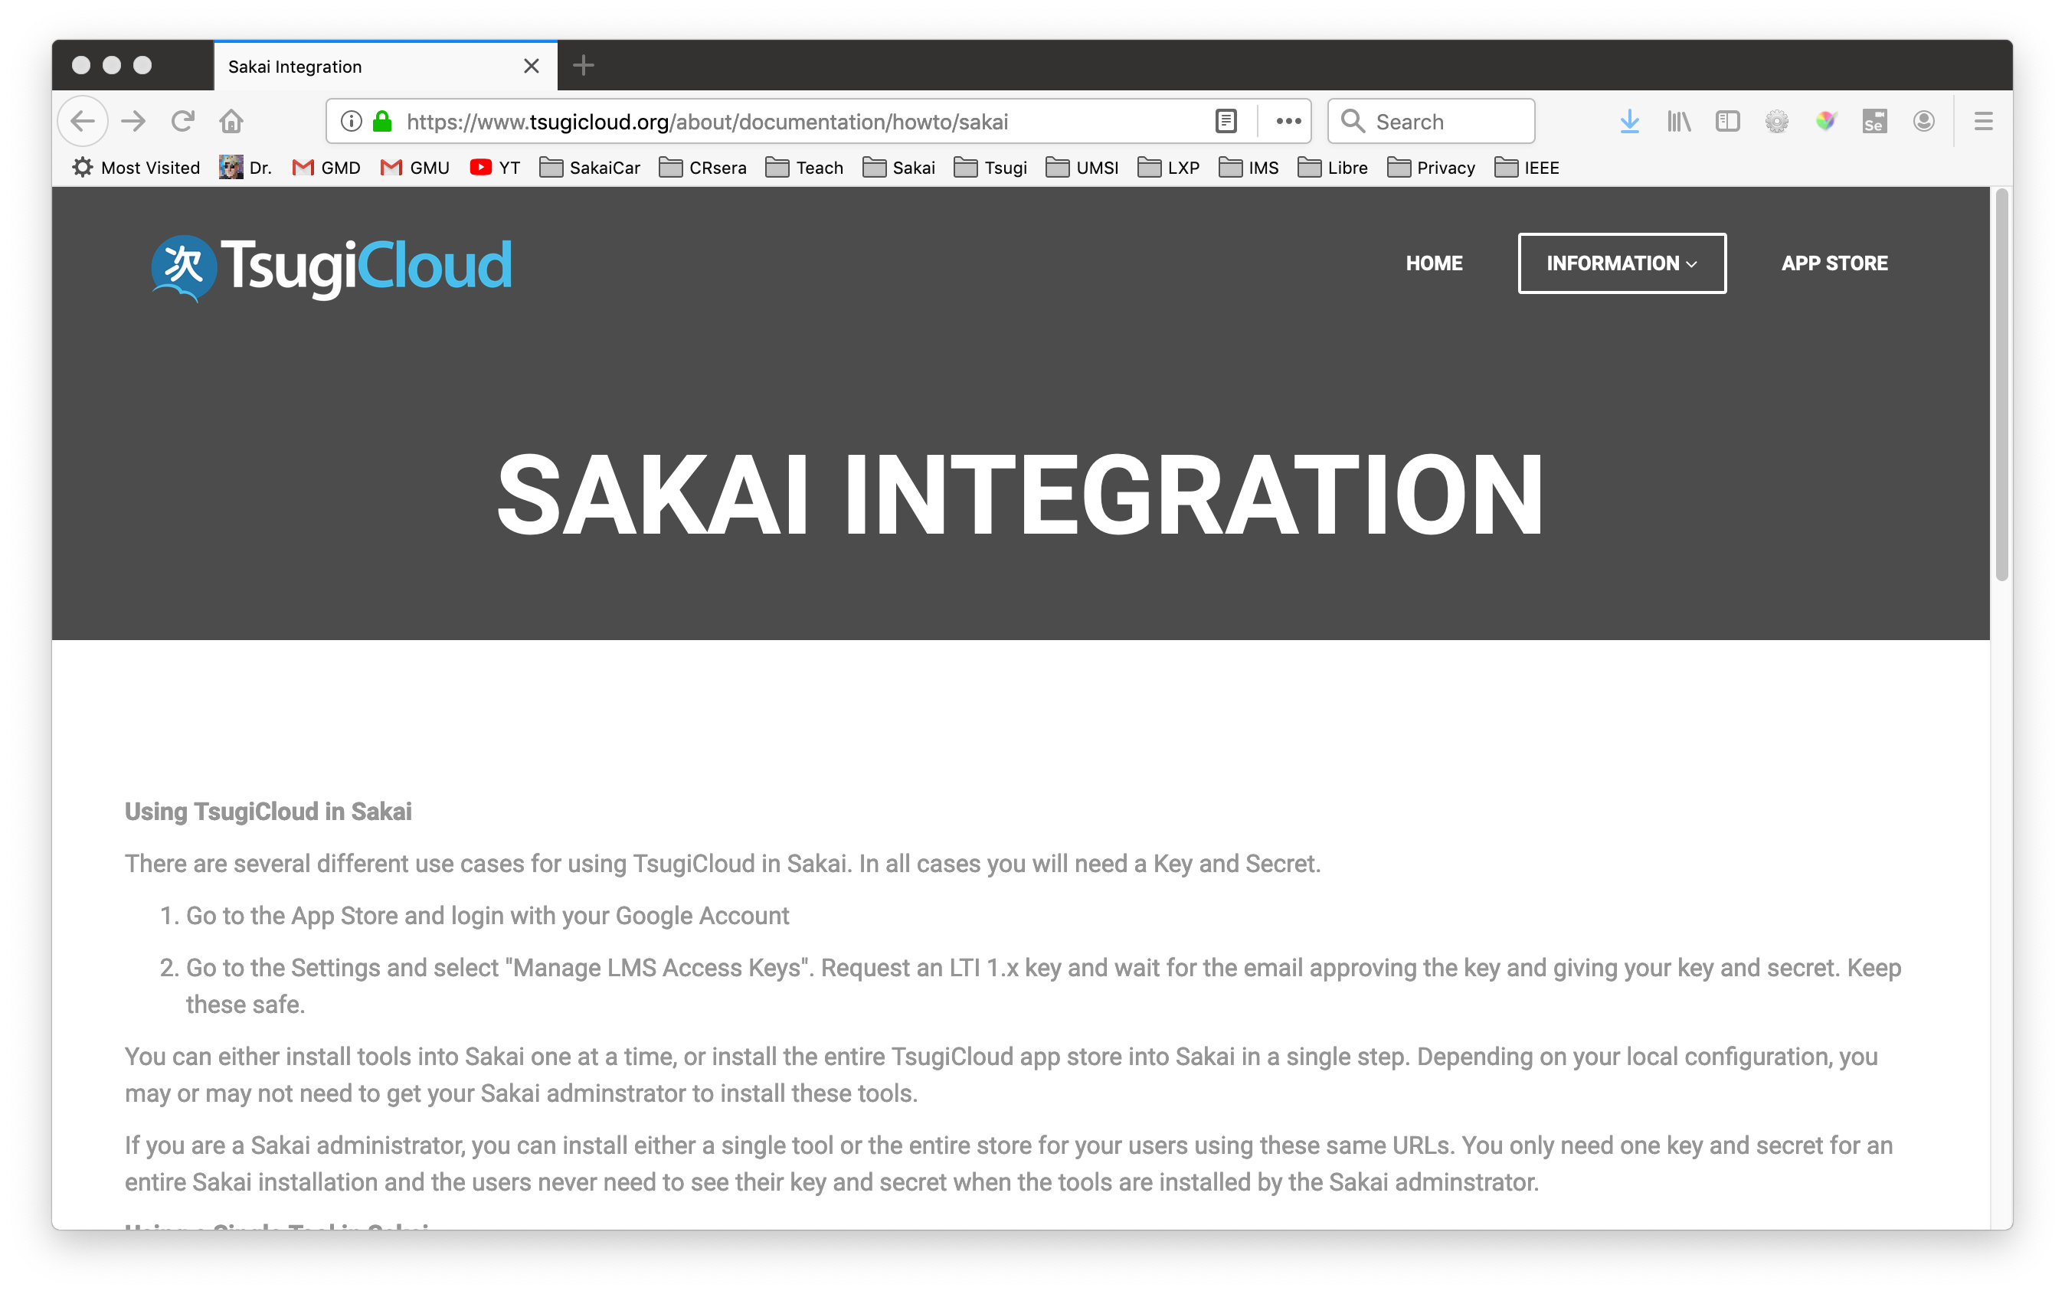
Free Hosted Learning Apps
https://www.tsugicloud.org/about/documentation/howto/sakai

Slide 15
Typical LTI Use Cases On Campus
Build problem to "patch" the LMS and make it work in the local environment
Purchase an LTI tool that fills a gap

Slide 16
Most LTI Tools Developed by IT
LTI
Group
Maker
Proprietary
APIs

Slide 17




LTI Tools/Content Purchased by IT
LTI
LTI Outcome
(maybe)

Slide 18
Learning Tools Used Many Ways
IMS LTI Advantage® IMS Deep Linking® IMS Common Cartridge®
The LMS
BUS uses ☺
次Tsugi
Tools
The LMS
CS Uses ☺

Slide 19
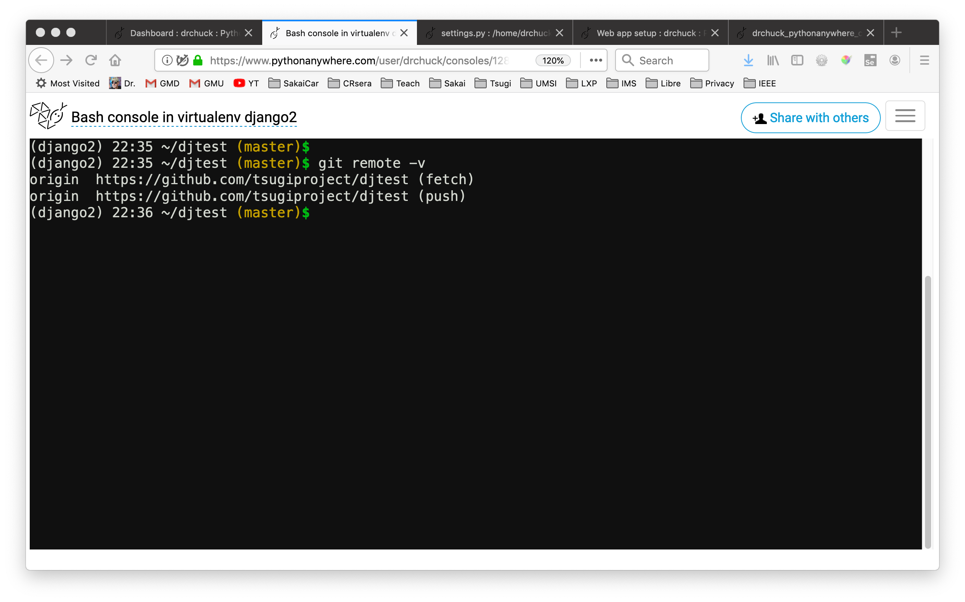
https://www.tsugi.org/awesome

Slide 20
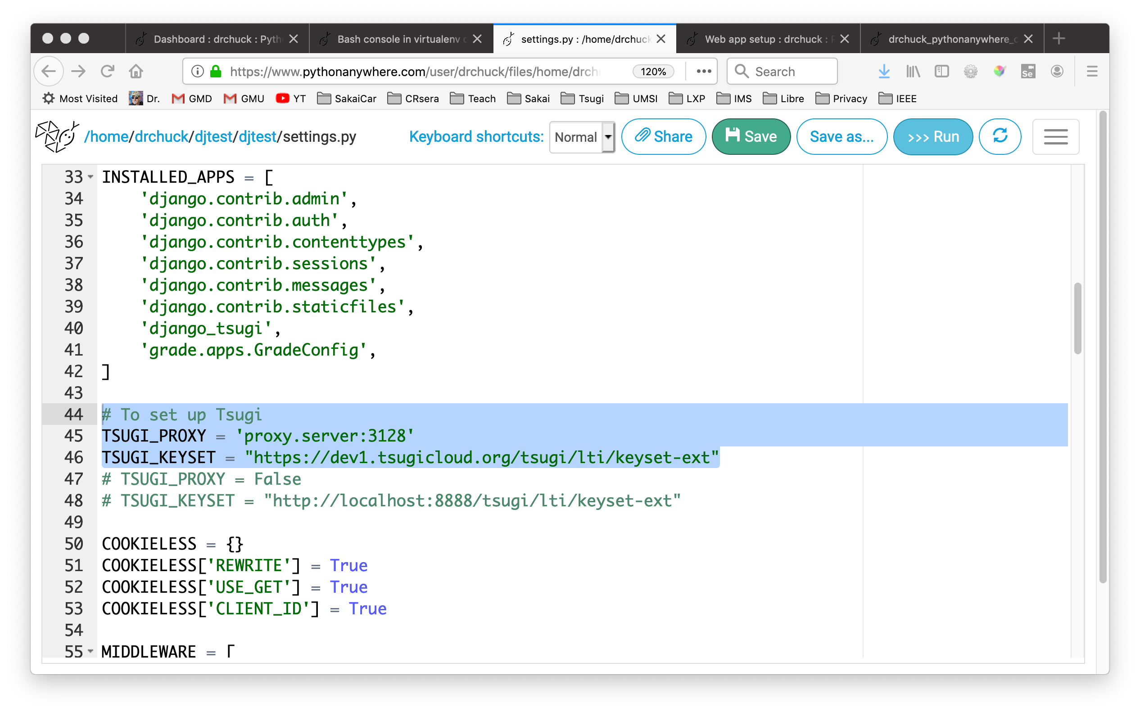
https://www.tsugi.org/awesome

Slide 21
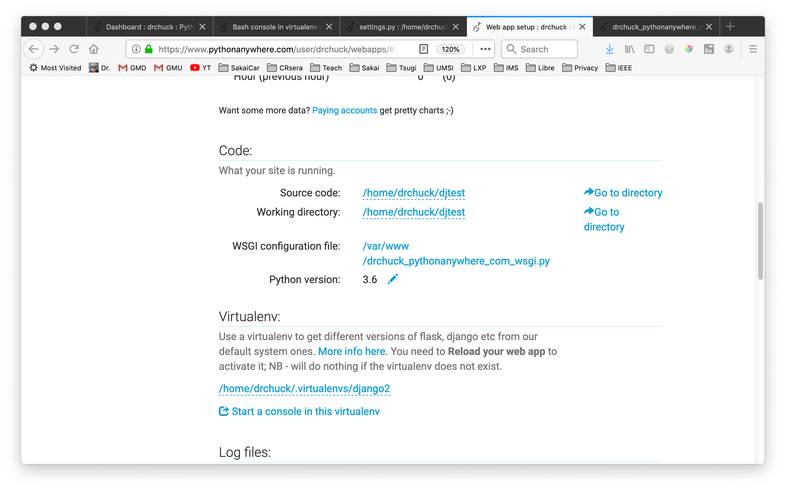
https://www.tsugi.org/awesome

Slide 22
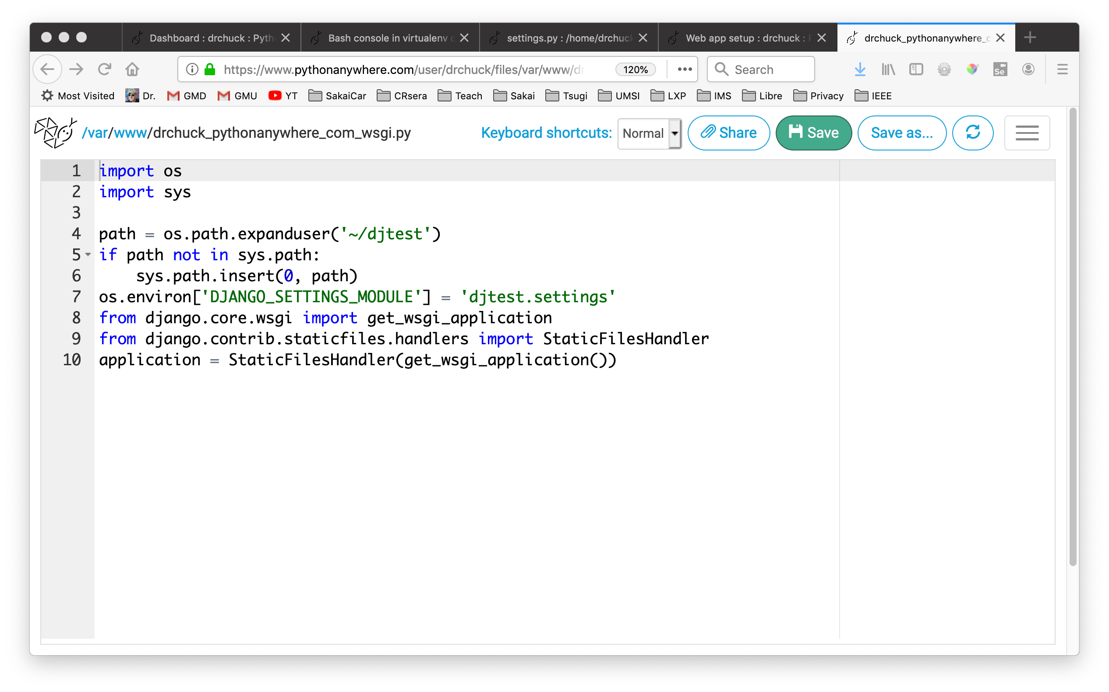
https://www.tsugi.org/awesome

Slide 23
Interoperability Standards

Slide 24


IMS LTI 1.1 (March 2012)
Finished March 2012
Launch + Grade Pass back (POX)
3001

Slide 25

IMS LTI Content Item (Sep 2015)
Use case: "Choose and configure tool from external source"
Learning Object Repository
App Store
Solid LMS uptake
Mild tool uptake
Tsugi is designed around Content Item
https://www.tsugicloud.org/about/documentation/howto/sakai

Slide 26
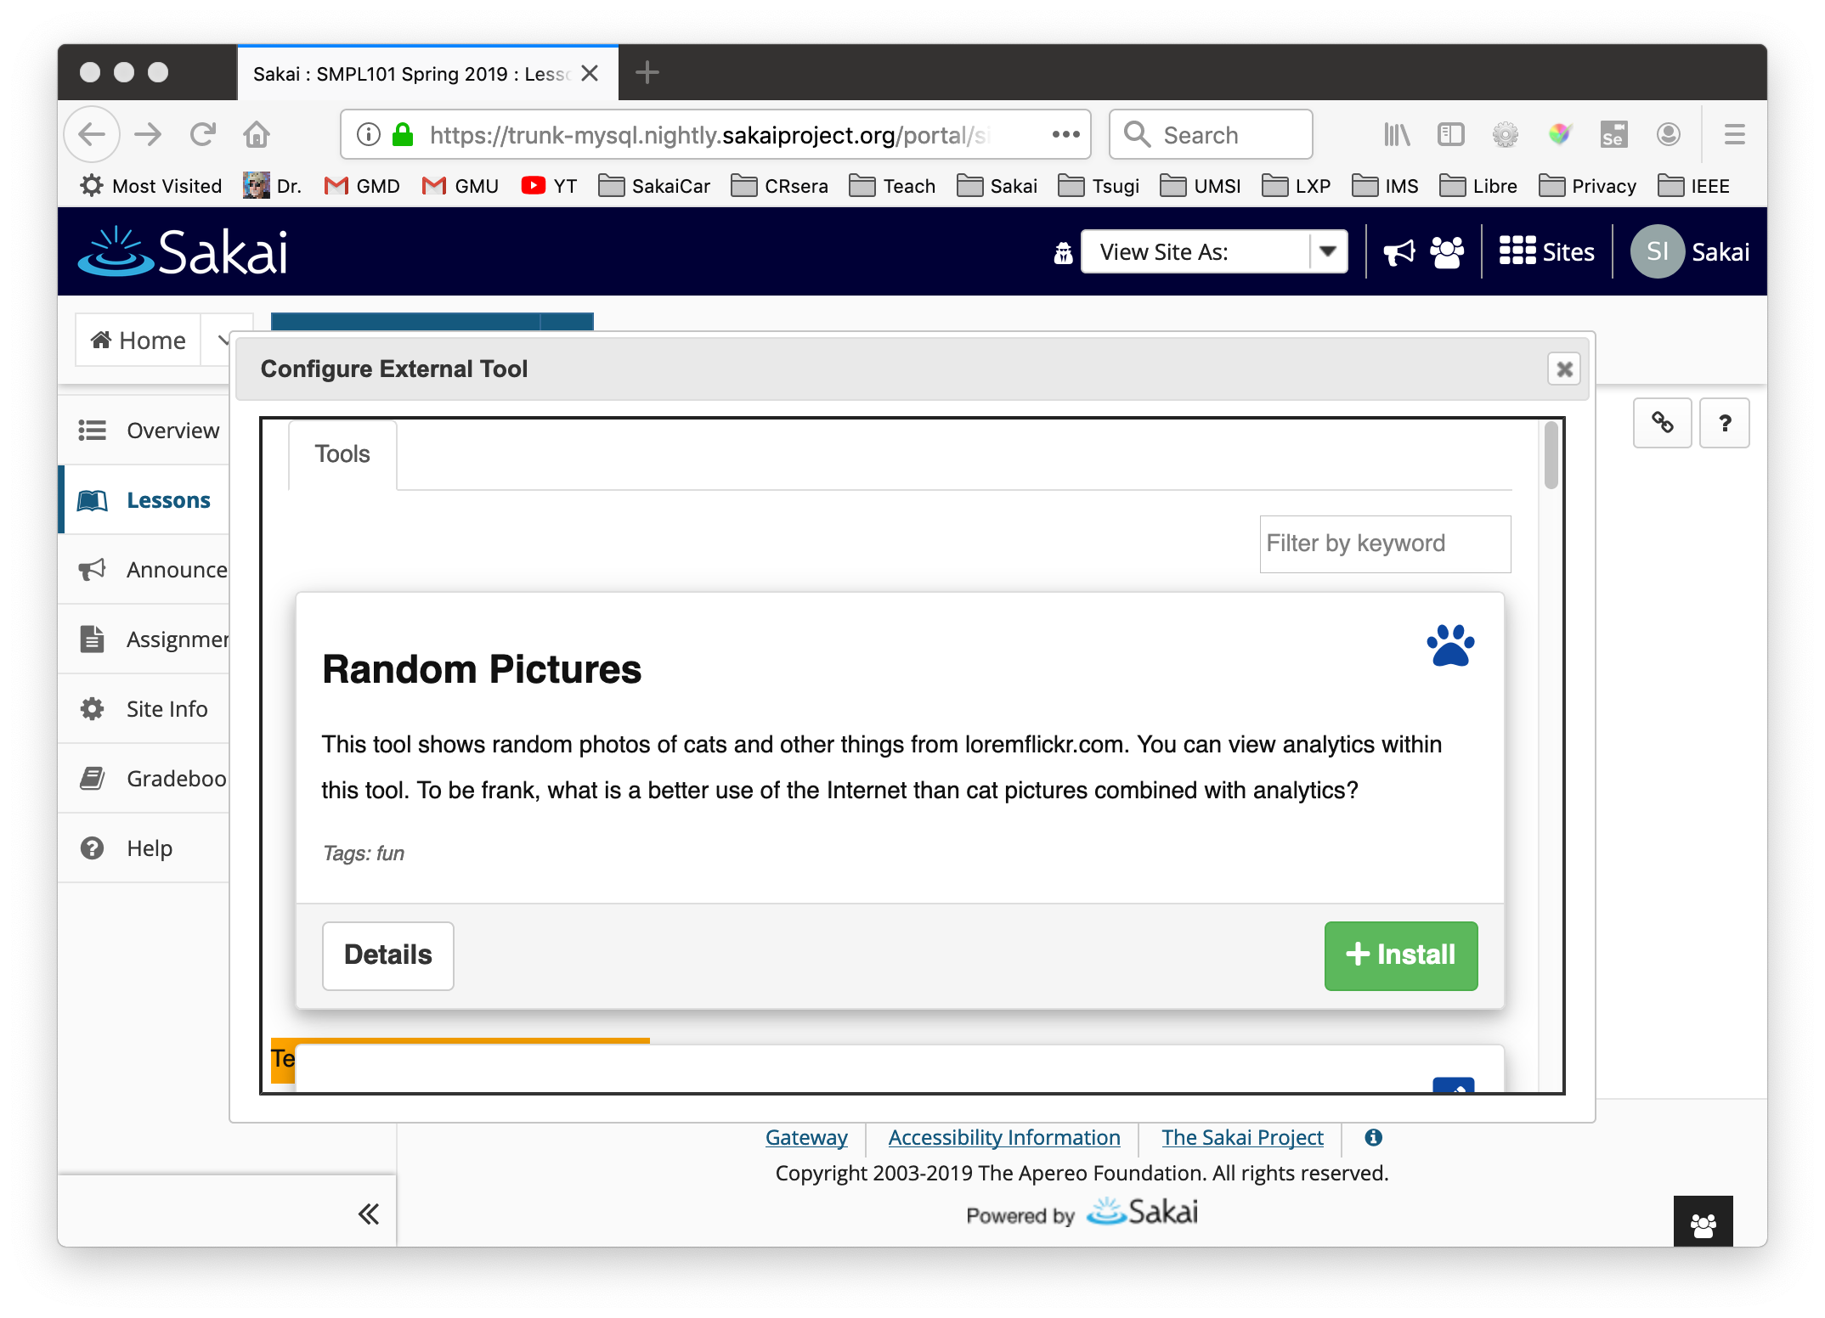

Slide 27
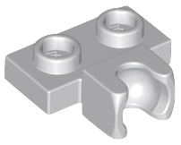
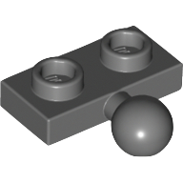

IMS LTI Advantage (2019)
New Security Model for Launch and Services
OpenID Connect
OAuth 2
"Required" LMS Services
Names and Roles (roster)
Outcomes Service (i.e. grade book)
Deep Linking
Rapid LMS Uptake (no tattoo needed)
14704
14417

Slide 28


IMS LTI Advantage (2019)
Notes:
14704 (Socket)
14417 (Ball)

Slide 29
Getting Started

Slide 30
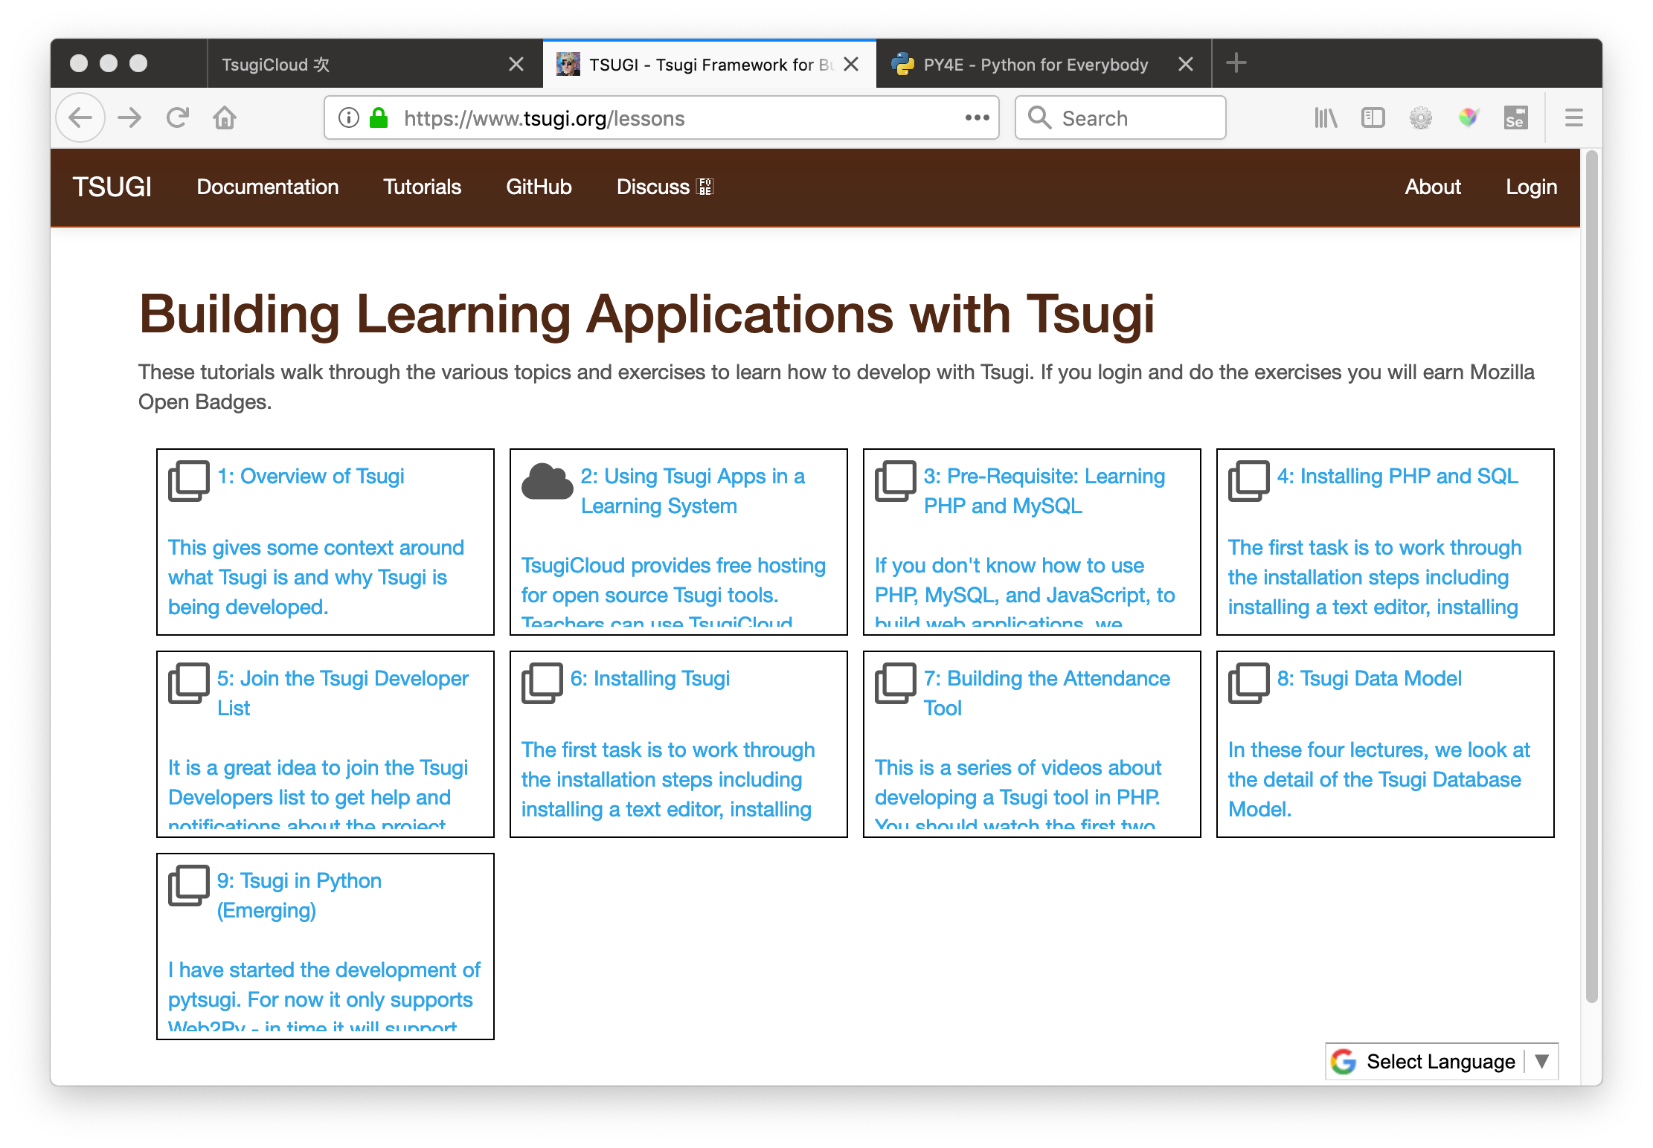
https://www.tsugi.org/lessons

Slide 31
<?php
// https://github.com/tsugiproject/trophy
require_once "../config.php";
use \Tsugi\Core\LTIX;
// Handle all forms of launch
$LTI = LTIX::requireData();
// Render view
$OUTPUT->header();
$OUTPUT->bodyStart();
$OUTPUT->topNav();
$OUTPUT->welcomeUserCourse();
if ( ! $LTI->user->instructor ) {
echo('<center><i class="fa fa-trophy fa-5x" style="color: blue;"></i>');
echo('<br/>You earned a trophy!</center>');
$LTI->result->gradeSend(0.95, false);
}
$OUTPUT->footer();

Slide 32




Tsugi Django
LTI 1.0
LTI 1.1
LTI 2.0
LTI Advantage
Google Classroom
…..
Tsugi
JWT Launch
RPC API

Slide 33
Django Tsugi
from django.shortcuts import render
from django.views import View
from django_tsugi.mixins import TsugiMixin
class GradeView(TsugiMixin, View):
def get(self, request) :
context = {'tsugi': request.tsugi}
return render(request, 'grade/main.html', context)
def post(self, request) :
grade = float(request.POST.get('grade'))
comment = request.POST.get('comment')
retval = request.tsugi.result.gradeSend(grade, comment)
context = {'tsugi': request.tsugi, 'retval' : retval}
return render(request, 'grade/done.html', context)
https://github.com/tsugiproject/djtest

Slide 34



Other languages??
LTI 1.0
LTI 1.1
LTI 2.0
LTI Advantage
Google Classroom
…..
Tsugi
JWT Launch
RPC API

Slide 35
The World of Tsugi PHP
Web Site - https://github.com/tsugiproject/tsugi-org
Tsugi UI - https://github.com/tsugiproject/tsugi
Tsugi PHP Library - https://github.com/tsugiproject/tsugi-php
Tsugi Static Assets - https://github.com/tsugiproject/tsugi-static
Koseu – LMS / Learning Object Repository
Python for Everybody - https://github.com/csev/py4e
Web Applications for Everybody - https://github.com/csev/wa4e

Slide 36
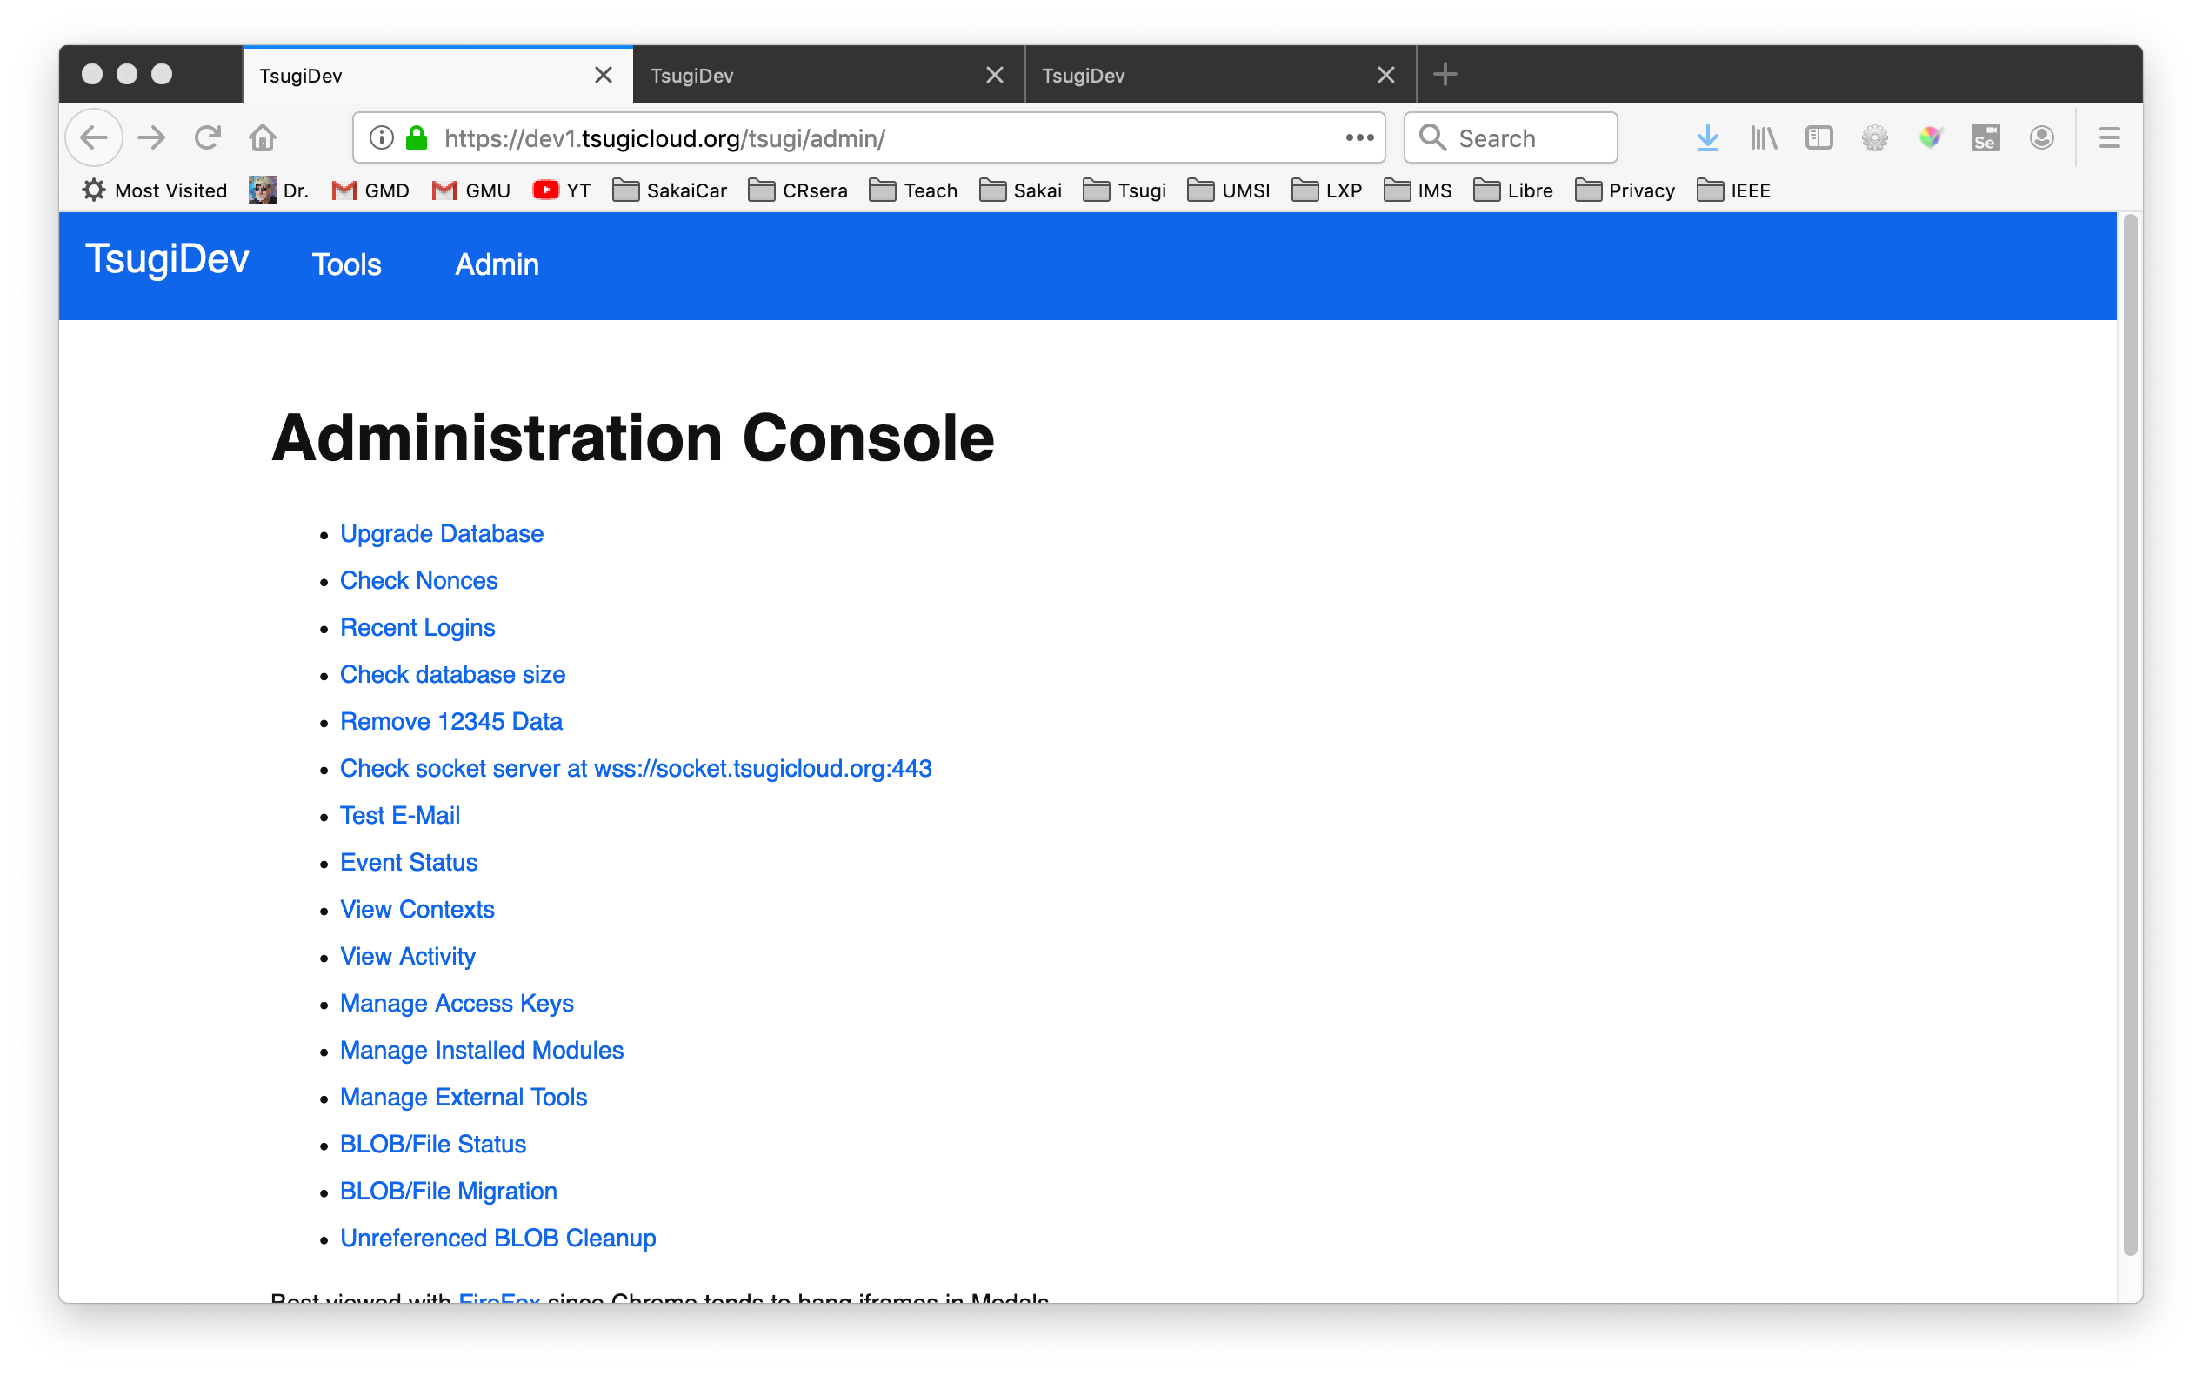
https://www.tsugi.org/awesome

Slide 37
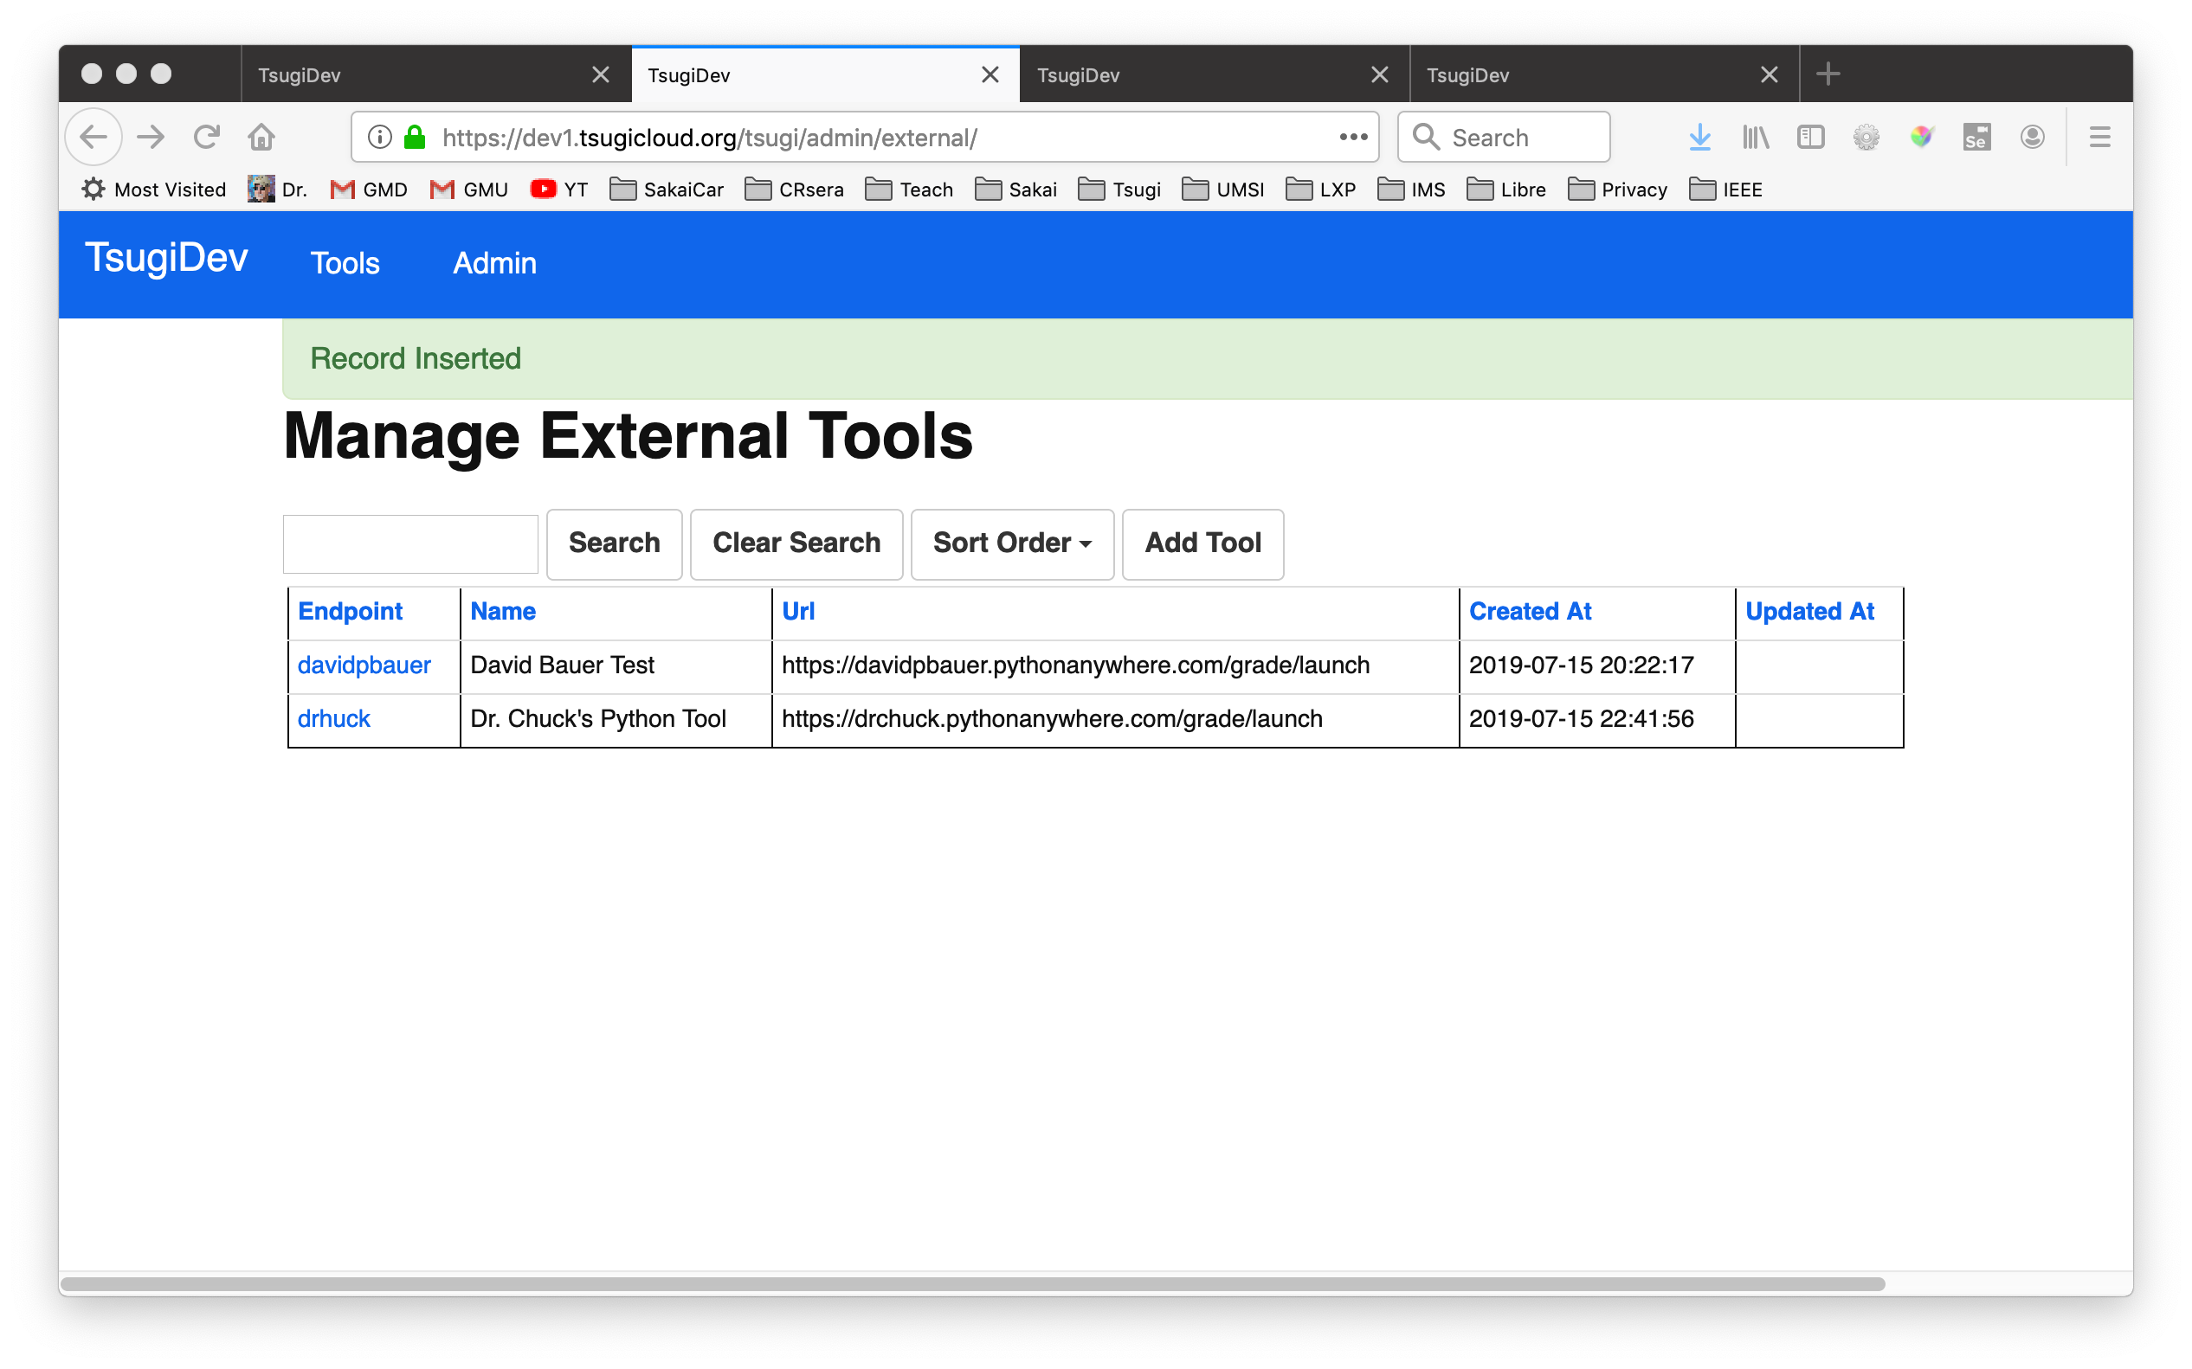
https://www.tsugi.org/awesome

Slide 38
https://www.tsugi.org/awesome

Slide 39
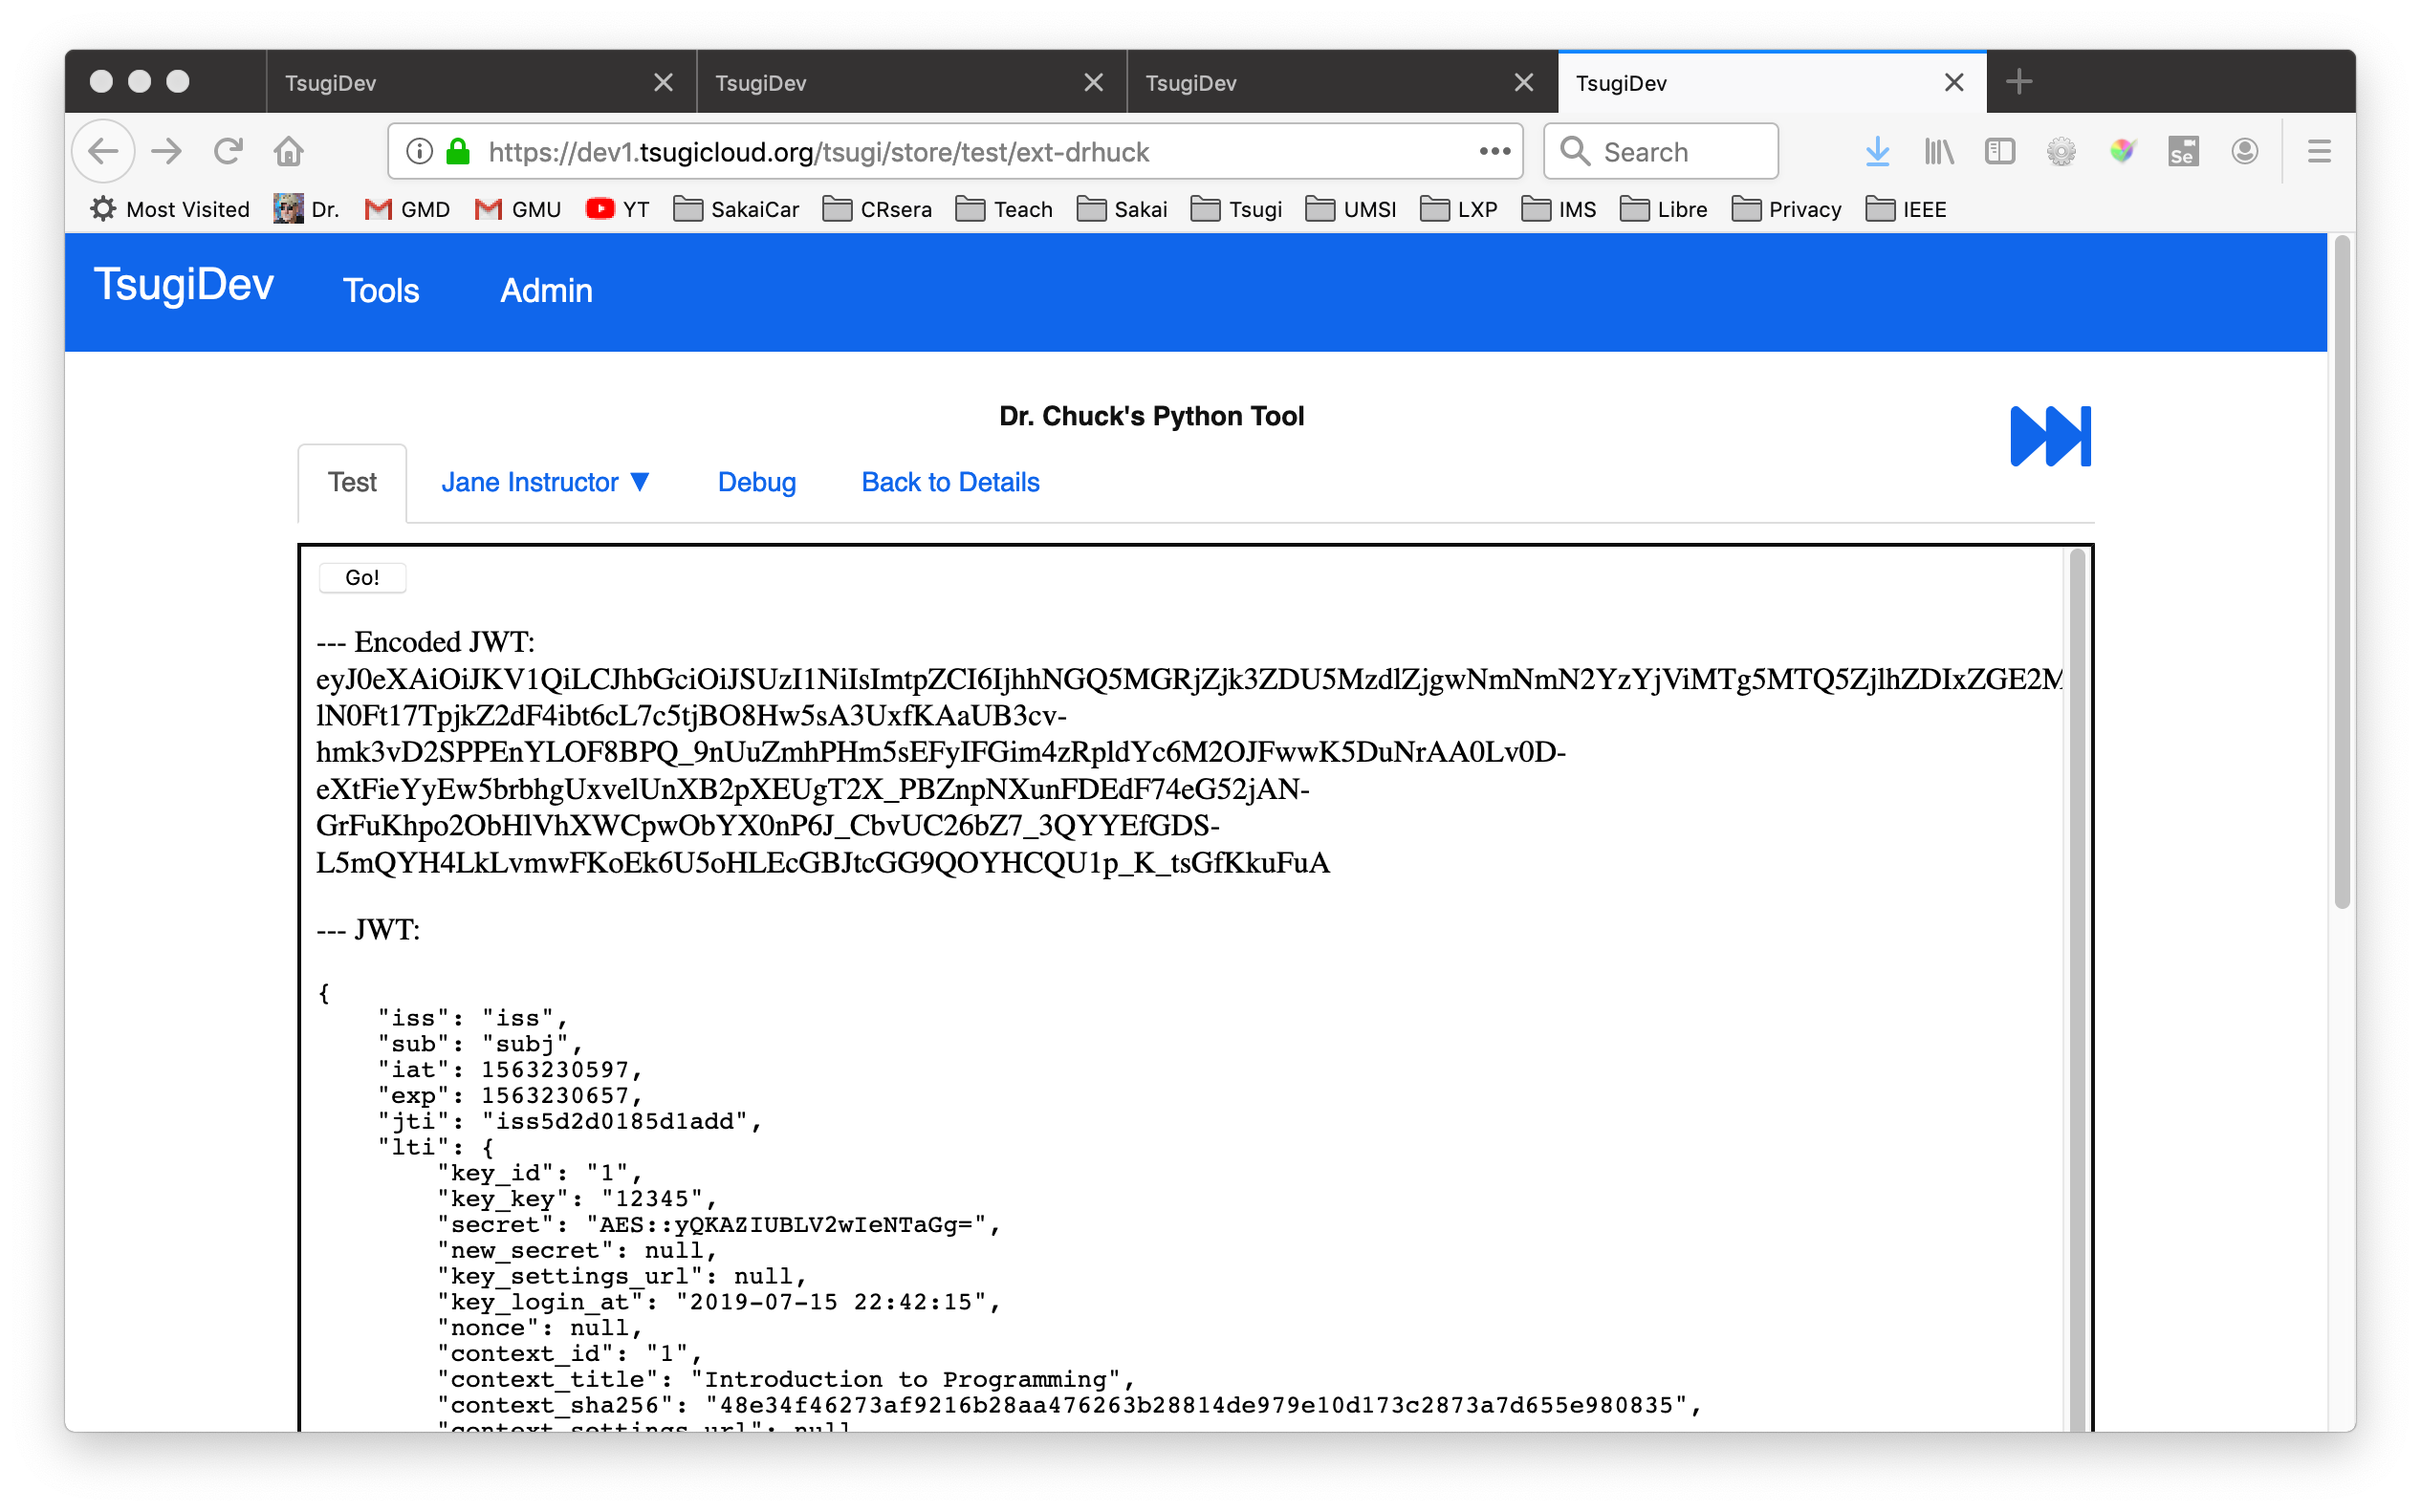
https://www.tsugi.org/awesome

Slide 40
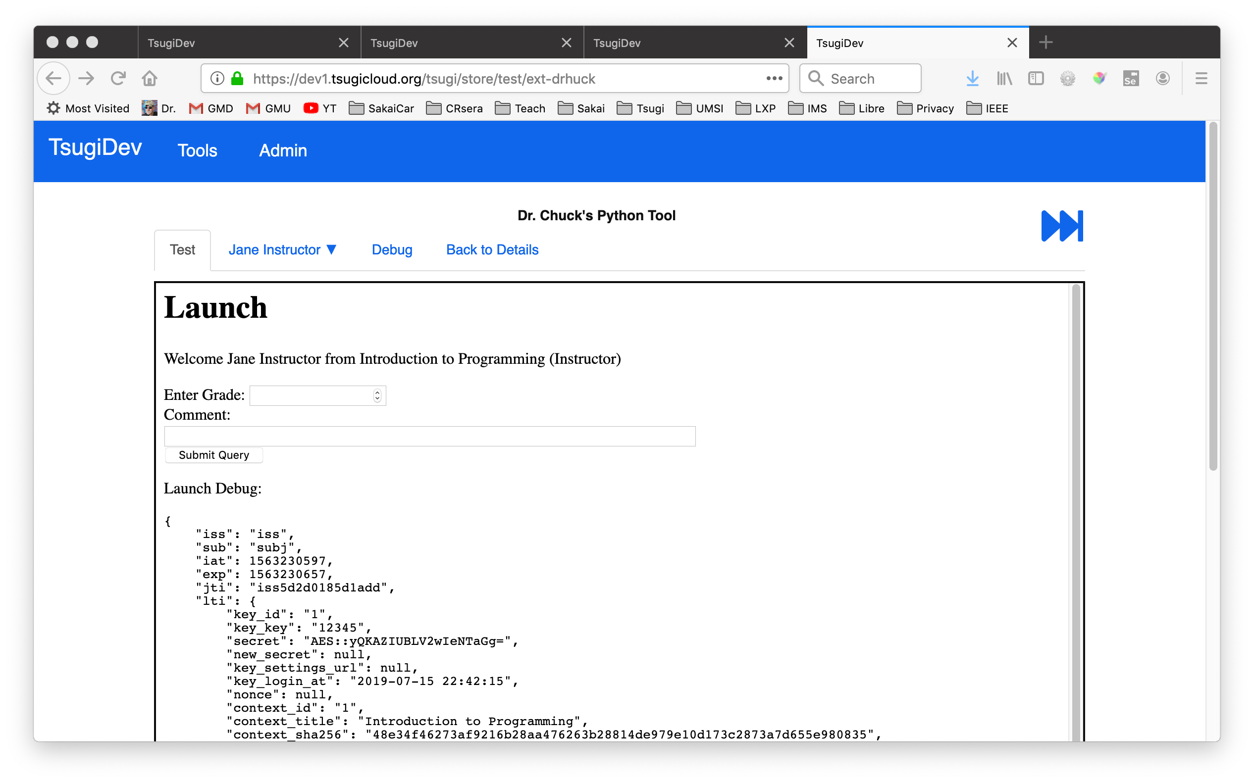
https://www.tsugi.org/awesome

Slide 41
Tsugi In Production
Scalable and Multi-Tenant out of the box

Slide 42


Scalable Multi-Tenant Tsugi
C
l
o
u
d
f
l
a
r
e
Amazon
F
I
r
e
w
a
l
l
EC2/ASG
Aurora
EC2/ASG
EFS
…
Elasticache
EC2/ASG

Slide 43
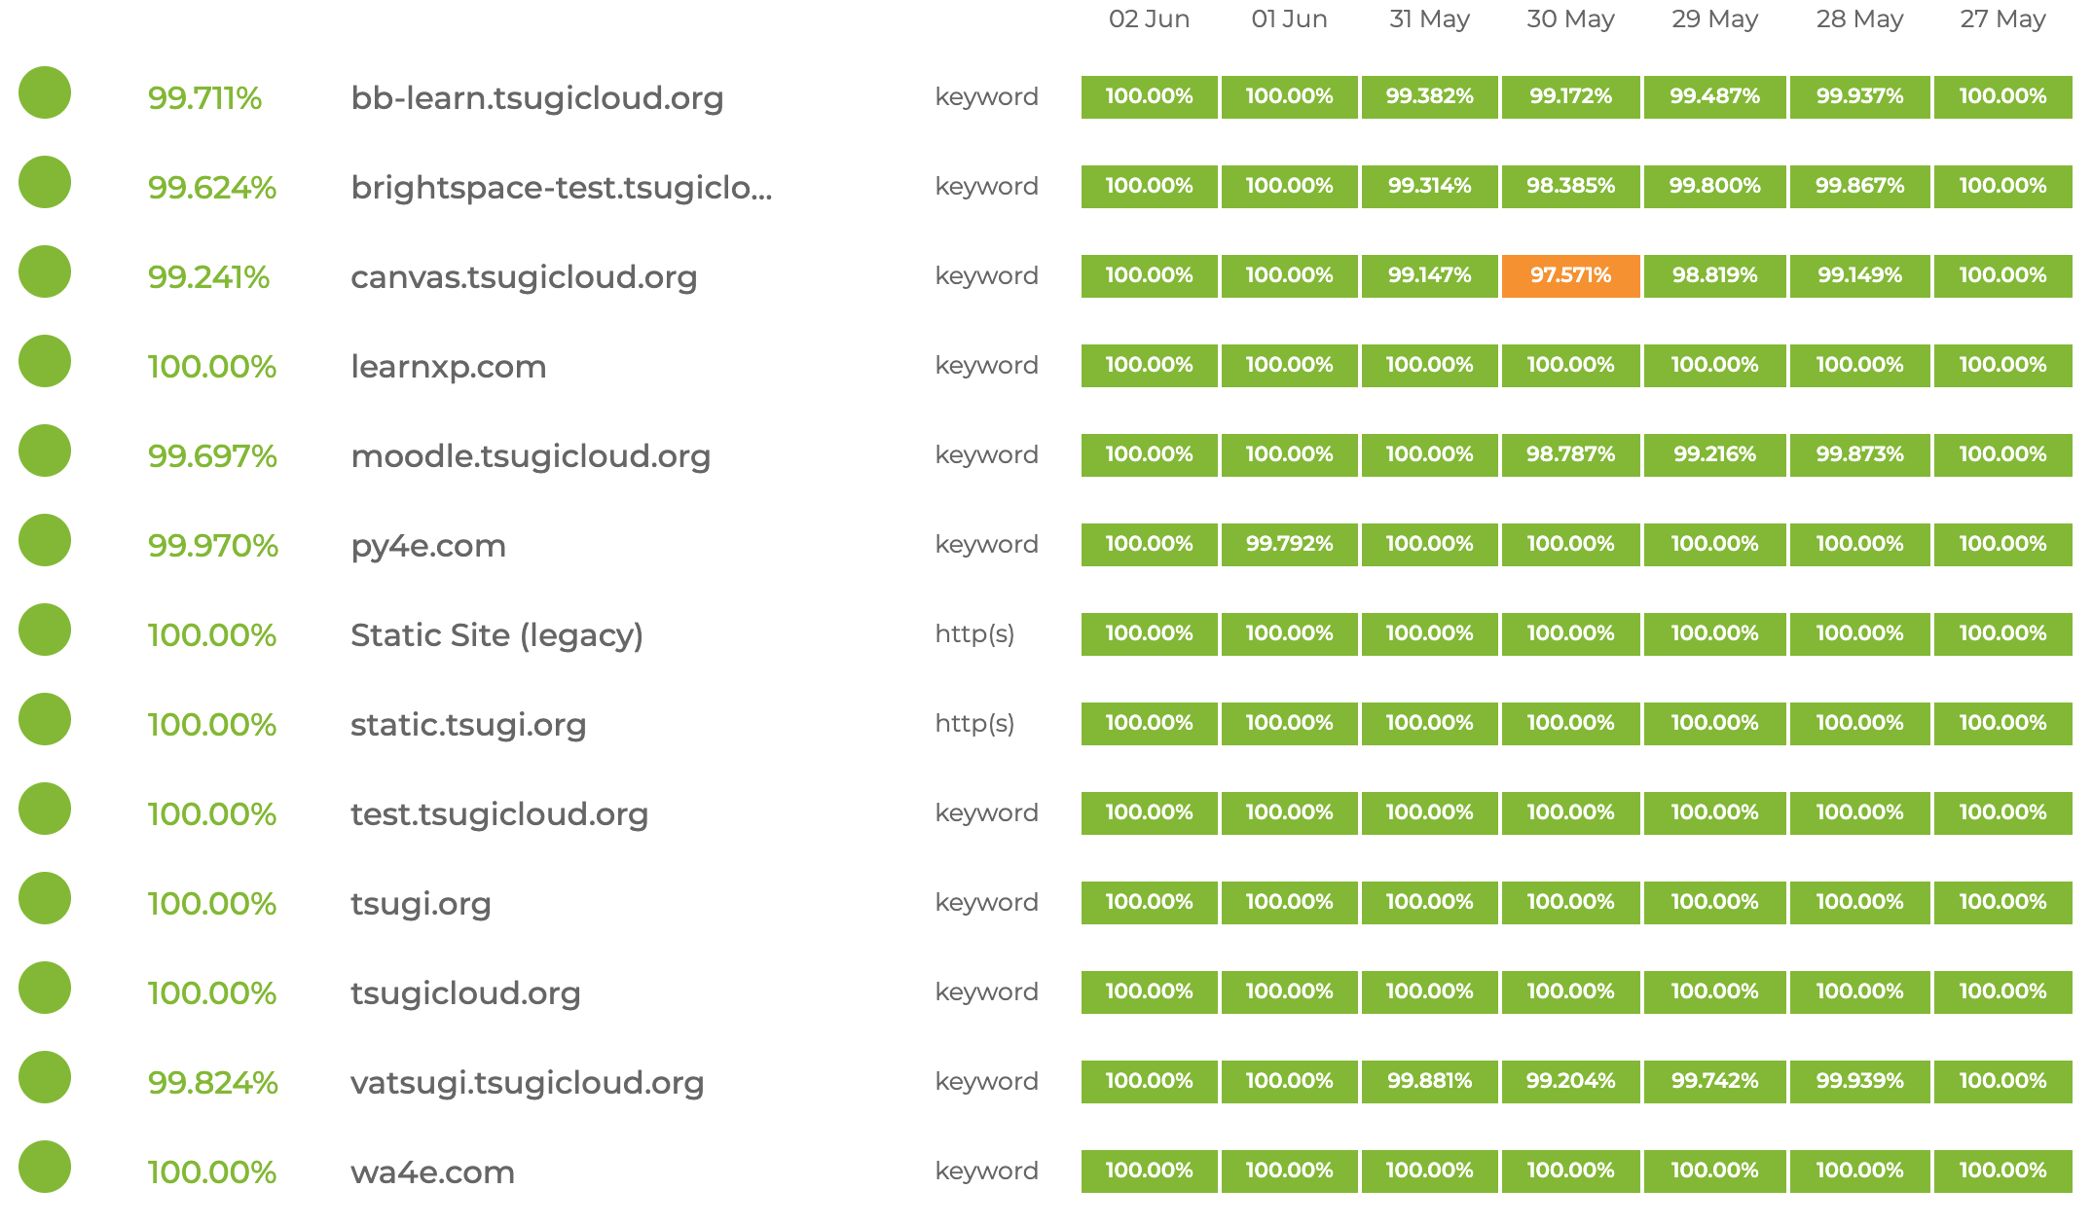
Tsugi Servers – status.tsugi.org

Slide 44
The Largest Programming Course in the World
Powered by Tsugi

Slide 45
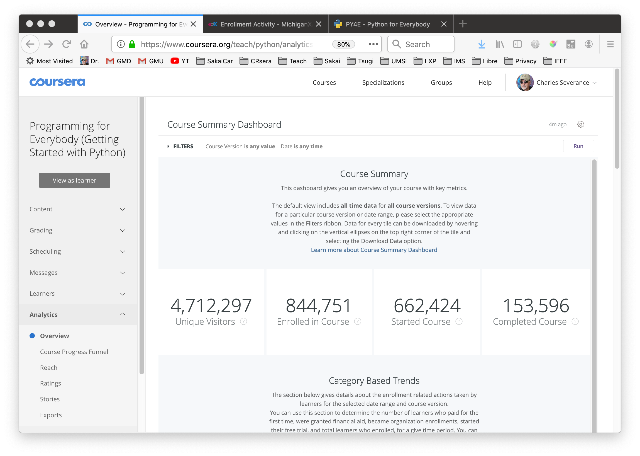

Slide 46
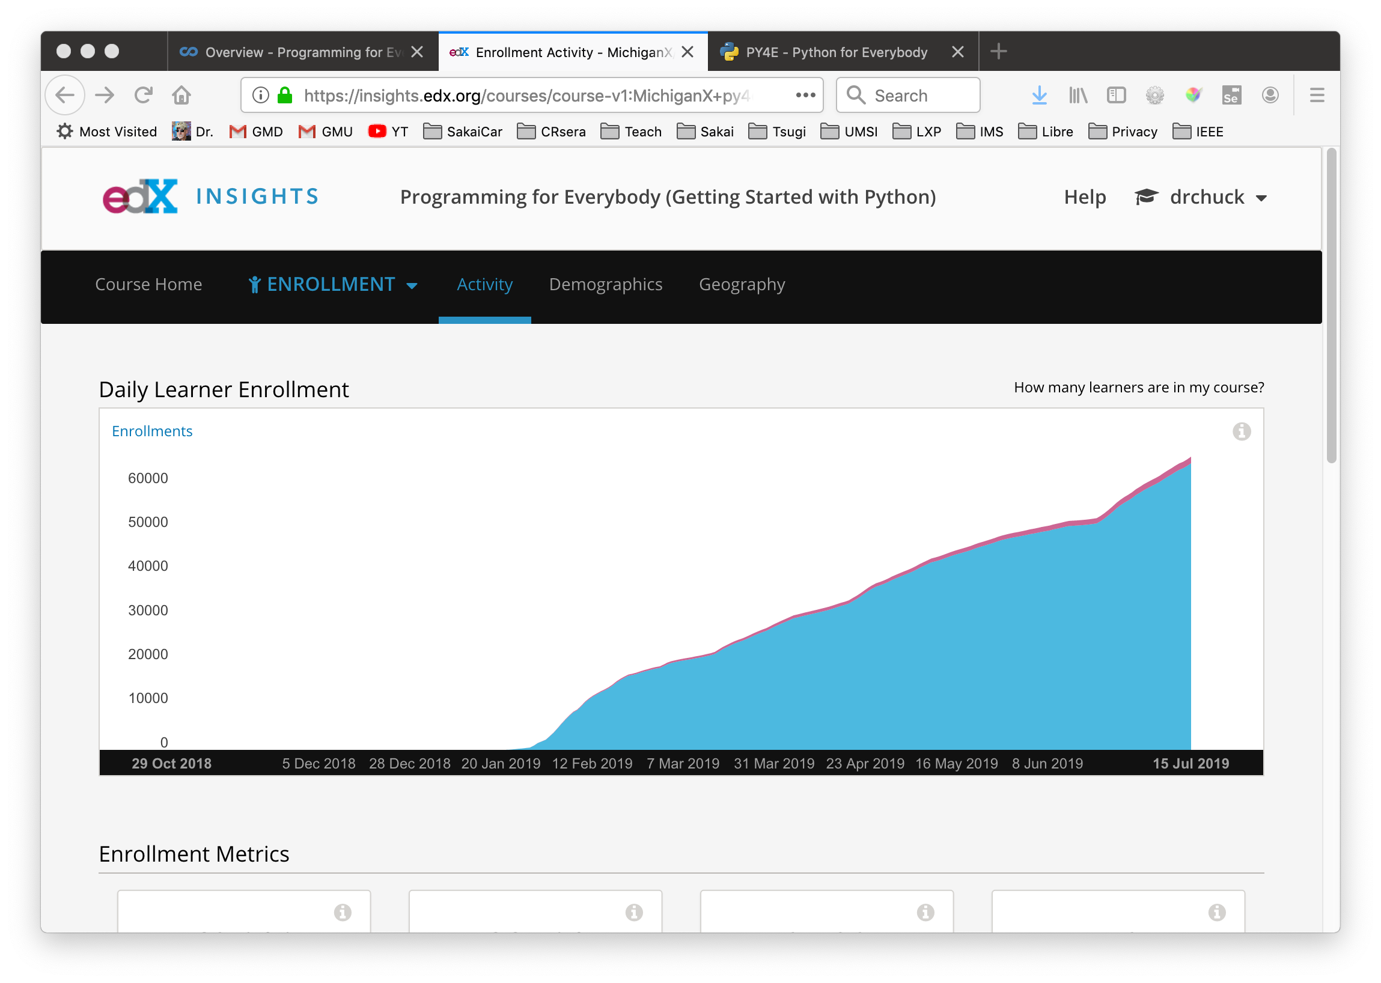

Slide 47
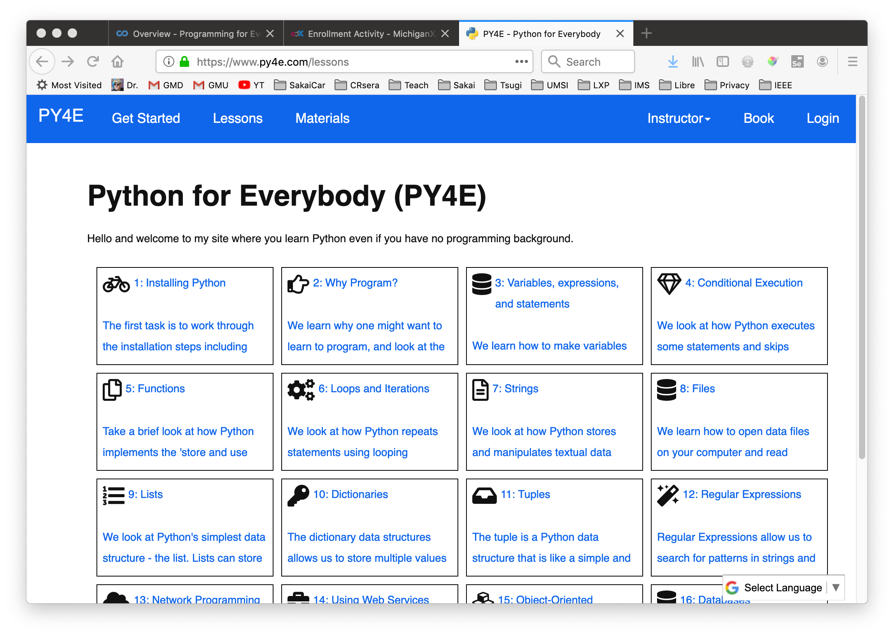

Slide 48
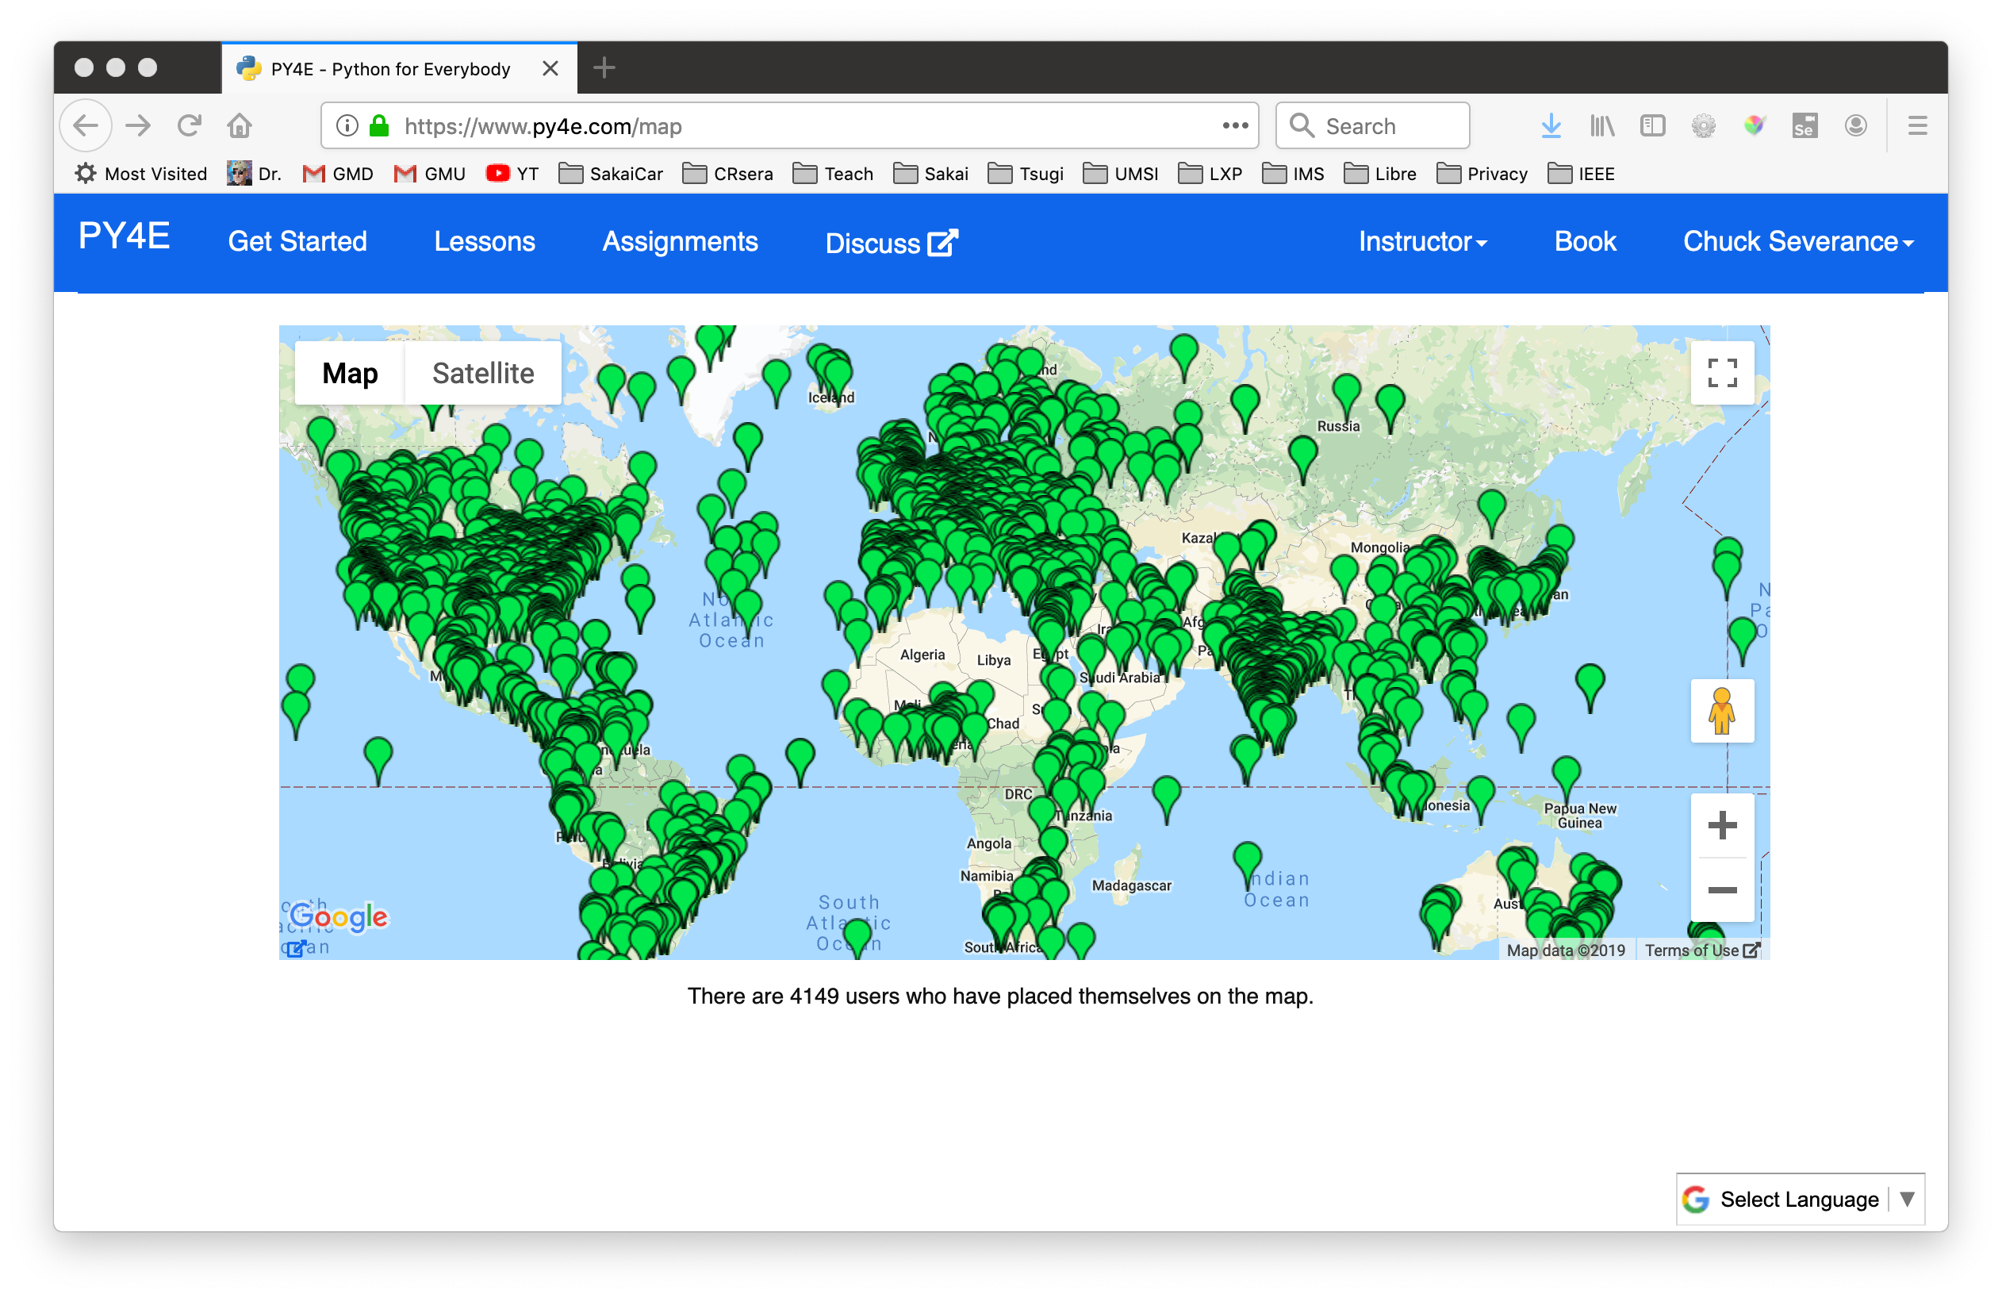

Slide 49
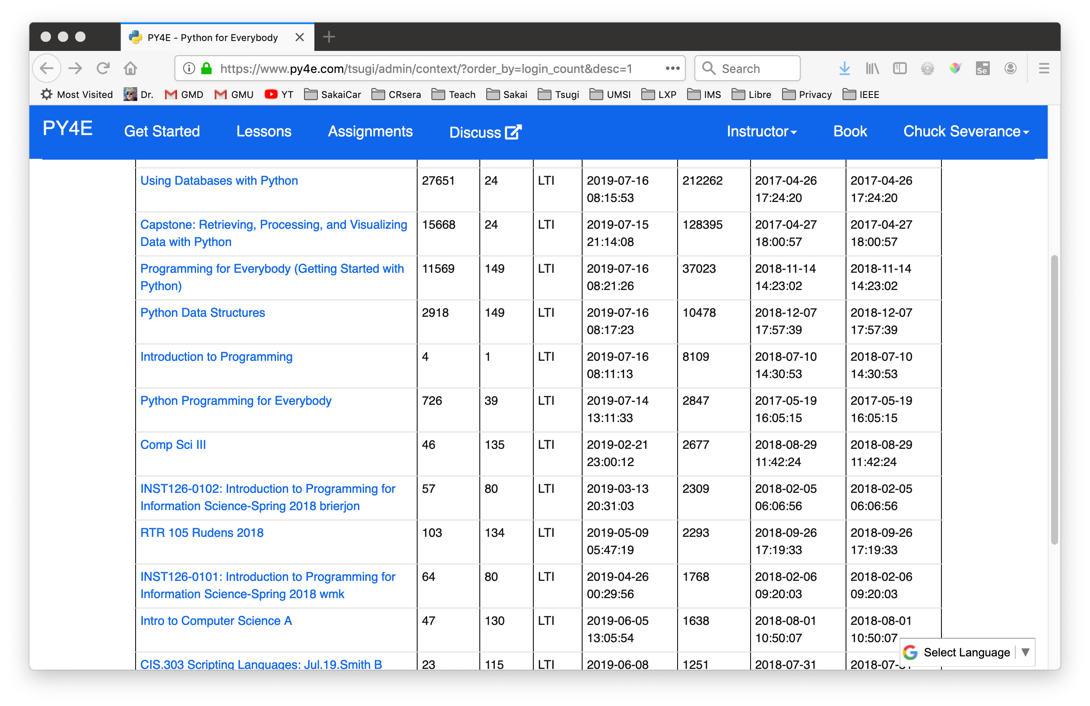





IMS LTI® IMS Deep Linking® IMS Common Cartridge®

Slide 50
IMS LTI Advantage® IMS Deep Linking® IMS Common Cartridge®
PY4E /
次Tsugi

Slide 51
Thanks for listening…
Teachers find and use tools in stores like www.tsugicloud.org
Instructional Designers build custom tools, assessment and content for your faculty (like University of Dayton)
IT / Support can quickly build learning tools for the LMS without reading specifications
Content Authors can build supporting materials and tools to use and share like www.py4e.com
https://www.tsugi.org/awesome

